Slide 1
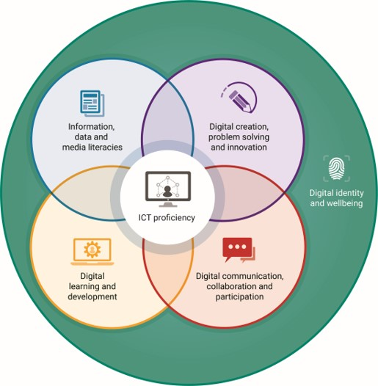

Talking about the Jisc digital capabilities framework – Part 3
With Helen Beetham and Shri Footring
Notes:
Shri: I'm here with Helen Beetham, the architect of the Jisc digital capabilities framework.
In previous presentations we’ve heard a bit about the background to the development of this framework but Helen, there was a lot going on - there was a lot of activity in this space at the time. Can you tell us a little bit more about that?

Slide 2
Evolution of the digital literacy/capability agenda: Policy context
National/international policy:
A human right (EU, UNESCO ‘5 laws’)
An aspect of citizenship and civic participation (Council of Europe, schools programmes)
A requirement for economic participation (Government
strategies and reports)
An international measure of educational outcomes
(OECD’s PSTRE measure)
New standards, frameworks and
programmes
Notes:
Helen: So you're right Shri, there's been a huge amount of interest in digital literacy or capability or fluency I guess at the level of national and international policy and also of course in the educational sectors that we work in. So thinking about that broader agenda, large international bodies like the EU, UNESCO have adopted digital capability as a human right.
You remember we talked about how we used the term literacy to mean something that is a fundamental right. The right to learn and rights to participate in certain ways and now digital access and participation have been considered in many parts of the world as a fundamental right. It is now an aspect of citizenship and civic participation, to open a bank account, to vote in some legislations and you can see that there’s international bodies as well taking on that agenda.
I guess where we come across it quite pointedly in the UK education sector is that our government like many others sees it as requirement for economic success both individually and as a nation. How digitally able our graduates, apprentices and professionals are is critical to how we do as a digital economy. And perhaps reflecting all of this it's now become part of the international measure of adult education outcomes, so they look and what they call problem solving in the technology rich environment alongside literacy and numeracy as a measure of adult learning outcomes. A kind of real sign of how mainstream it’s become I guess and around that of course there's lots of new international standards and frameworks and initiatives that seek to develop this thing called digital capability internationally and within different nation states as well.

Slide 3
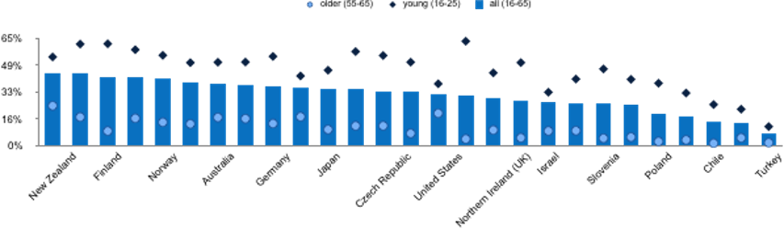
Evolution of the digital literacy/capability agenda: Adult skills
OECD survey of adult skills (PIAAC 2017): % of adults scoring 2 or 3 on the ‘problem solving in a technology rich environment’ (PSTRE) measure
Notes:
There's a couple of visuals I want to share Shri that I think illustrate why this has become such a big agenda internationally. And the first is that survey of adult skills I mentioned. This is a data visualization of the 2017 outcomes for the ‘problem solving in a technology rich environment’ measure. I think there's some issues with how the OECD assesses that but it's been a very robustly tested measure and you can see how that is confirmed round the middle of this graph although in common with a lot of the more developed economies of the global North are young people don't actually do as well relatively as young people in other parts of the globe.
And so you can see that as a measure of perhaps the future economic potential of a society that present participation levels this ‘problem solving a technology rich environments’ become really crucial and it's really crucial that our education sector understands the need to develop this kind of capacity in students.

Slide 4
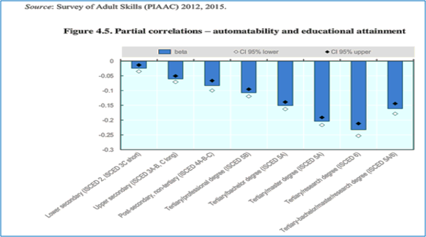
Evolution of the digital literacy/capability agenda: Automation
Risk of job automation based on level of education. From Automation, skills use and training (Nedelkoska & Quintini 2018, based on earlier PIAAC findings)
Notes:
And this visual is about the impact that the digital environment is having on the on the whole of the economy.
So this is a nice visual that shows the risk of jobs being automated based on the level of education that most people who do those jobs have and you can see that the lower the higher the level of education required to do a job the lower the risk of automation.
And I think again this shows that we’re working in a context where digital has completely reshaped what it means to work. It's not just the case that when you go to your first job from college or university you might well encounter a computer, it is at the very nature of the work you're doing that has been changed. The way that you engage with it, the platforms used to engage with it have probably changed as well. So I think this shows not only that we need to think of digital skills as kind of economic resources, but we also need to think about the world our students moving into and it how radically is being changed. And what kinds of learning and what kinds of resources they need to be able to thrive in that world.

Slide 5
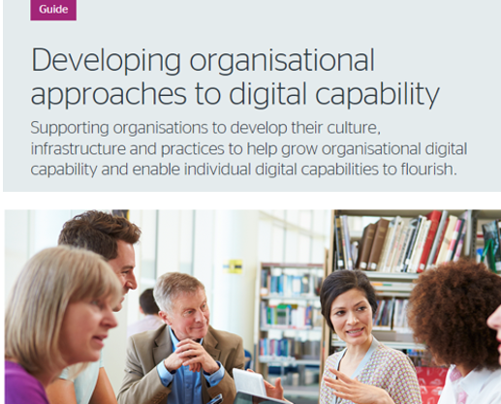
Evolution of the digital literacy/capability agenda: Sector context
FE/HE sector agenda:
Changing nature of graduate work
New student markets
New modes of study – often larger, more diverse cohorts
Student experience and expectations
Building capacity
New methods within subject areas
New pedagogies
New body of research, knowledge and
evidence (journals, books, CoPs,
conferences and events)
Notes:
Shri: That's really interesting thank you Helen. But what are the implications for Jisc members, for universities colleges and other learning providers?
Helen: Well I guess the global agenda that I just touched on impacts from the outside on what universities and colleges do. So there's the changing nature work, what of graduates of college and universities are likely to be doing. as we've mentioned. And there's also the aspiration is that our sector has to move into new student markets whether that is providing students with online opportunities or helping students to learn while they are based at home or work, attracting international students and that’s an agenda for FE as well as HE of course and technology provides the opportunity to do that but it also means that maybe colleges and universities have to have new business models and new pedagogical approaches to meet those kind of changing requirements.
We can see of course that students want to study in different ways and they have the opportunity to do that and so teaching staff might be dealing with larger more diverse cohorts, cohorts that are participating in a variety of different ways. And students have a lot of expectations about how digital might be used in their learning. Not always accurate but often quite demanding expectations and the sector has been really motivated to try and meet and exceed those expectations or to support students in having a really good experience of learning digitally and that's a big part of the agenda the Jisc is responding to and the work that I've been just doing the last few years.
I guess from a more of a organisational perspective you know our colleges and universities need to see that they are building capacity to respond to all of this whether that's building their staff capabilities so that the professional staff are able to meet the needs of students and the needs of digital research and scholarship and the demands of the environment they are in, or whether it’s the systems themselves that are needed to build capacity.
And that's all coming from the outside if you like to impact on what it is that universities and colleges do but I think we shouldn't lose sight of the fact that we are also very powerful in this agenda so the agenda about digital literacies that we were talking of earlier today, about your own masters and how you engaged with this as a subject to study, and increasingly it is being studied as a subject. So colleges and universities in the UK that have particularly been leading this, have been establishing new methods for using digital research technologies, digital teaching technologies, digital data resources. There have been whole new movements in teaching and learning, new pedagogies that have come about from within our universities and colleges, from the Internet itself and many of the new technologies that are associated with these radical changes came out of our universities and colleges.
And you were asking me earlier about where some of the ideas of the framework came from well there's a huge body and a growing body of research and knowledge and evidence about what this thing that is digital capability is what the evidence is for it being useful throughout life you know where we can see it being practiced well that's hold journals and conferences you can go soon books you can read and you know Masters degrees you can study in this space so while we talk about FE and HE having to respond to this big global agenda of change I also think we need to be really confident that we are also providing a lot of the materials, a lot of the know how, the creative ideas that are actually driving it forward as a subject area.
Shri: Thank you. So it’s almost as though we're talking about 2 different things here. We are not only talking about the skills that people need when they go into employment and function as part of the digital society but we're actually talking about the transformative potential of the technology itself to transform learning and teaching and assessment, would you say?
Helen: Absolutely and I think sometimes we lose sight a little bit a bigger picture – that we are in the business of preparing students and preparing our institutions for a very different kind of world. And we can have a say in what that world is. Technology doesn’t decide. We decide.
And yet a lot of us are concerned with the day-to-day business of making this work, helping students to get access, making the systems talk to each other and these are part of the same picture. They are different lenses on it. That’s why it’s useful to have a broad framework and set of definitions that allow us to place those different lenses on the same thing.

Slide 6

Evolution of the digital literacy/capability agenda: Sector response
UK FE/HE response
Institutional and government funding (e.g. Jisc’s programme)
Institutional projects and initiatives
Curriculum renewal (e.g. via graduate attributes)
QAA Review topic 2015-16
Benchmarking (e.g. new questions in NSS/Student Engagement surveys, Insights service)
Notes:
(no audio narration or notes)

Slide 7

Evolution of the digital literacy/capability agenda: Framework
Jisc 2015
Review of almost 100 frameworks and resources in use
Interviews with key organisations and stakeholders
Engagement with professional bodies
Outcomes
Existing ‘7 elements’ well liked but
not extensively embedded
Reflected current thinking (had influence)
Need for a clearer structure and progression
More input from stakeholders to support different versions/adaptations
Need for a variety of applications that made sense in practice
Notes:
(no audio narration or notes)

