Slide 1

Building digital capability
September 2020

Slide 2
Why is digital capability important?

Slide 3
Why is digital capability important?
We need all staff and students’
to acquire the digital skills and capabilities for living, learning
and working in a digital world
Graduate work is being transformed by digital technologies and data
(IPPR 2017: Managing automation)
‘Alongside qualifications, character, behaviour and attributes are a clear priority for employers’ (CBI/Pearson Education and Skills Survey report 2019)
Only 18% of leaders believe UK school leavers and graduates have the right digital skills. (Deloitte, 2019)
Skill gaps among workers and organisational leaders have the potential to ‘significantly hamper new technology adoption and therefore business growth’ (WEF, 2018)
Changing world and working landscape
Evidence employers are looking not just for knowledge…but broader skills
Digital capabilities are key employability skills – and we need to go further
Changing expectations of learners
But….evidence of a skills gap
Notes:
We all know that world is changing and is increasingly digital, and our working landscapes are similarly changing, with automation, AI and technology transforming workplaces.
So we now need to prepare learners for a future that may look very different from today – for jobs that don’t currently exist (one report (WEF) suggested 65% children entering primary school will work in jobs that don’t currently exist) and multiple careers as the norm, with the only constant being change.
Transferable, higher level and lifelong learning skills are increasingly critical in this environment as the speed of change requires new skills and re-skilling.
Students expectations of their educational experiences are also changing – our student panel at Digifest highlighted that they see digital as a way of getting ahead in a competitive job market..
BUT we also know that there is a skills gap – both digital and higher level skills as this quote from the Deloitte Disruption Index report in 2019 shows. The World Economic Forum (WEF) identify skills gaps among workers and organisational leaders as having the potential to ‘significantly hamper new technology adoption and therefore business growth’ (WEF, 2018).
To be employable in the modern world we need to develop students as digitally capable lifelong learners – And we need to go further, in developing digital entrepreneurs that can help shape their future employment.

Slide 4
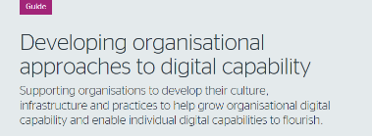

What organisations have told us
“It’s really important that staff have the right digital capabilities. It is important for a number of reasons but primarily the academic curriculum needs to reflect the digital skills and attributes that we expect from our graduates.”
Professor Malcolm Todd, Pro vice-chancellor, academic and student experience,
University of Derby

Slide 5


What the students are telling us
Quality of support to develop digital skills
66 % of FE and 60% of HE learners rated the quality of support they received from their college to develop their digital skills as ‘good’, ‘excellent’ or ‘best imaginable’
27 % of FE and 29% of HE rated it as average and 7 % of FE and 11% of HE learners rated it as ‘poor’, ‘awful’ or the ‘worst imaginable’
Discussing learners’ digital skills
20 % of FE and 21% of HE learners did not discuss their digital skills either during induction, during one to one sessions with tutors, in lectures and classes or with other learners
Notes:
The results of our 2020 student surveys provide valuable evidence of the need to enhance the way we help students develop digital capabilities.

Slide 6
What the students are telling us
Organisational support for learners to develop their digital skills
51 % of FE and HE learners agreed they received guidance about the digital skills they needed for their course
41 % of FE and 34% of HE learners agreed that their college provided them with the chance to assess their digital skills (eg for career planning)
Developing digital capabilities:
“Not basic things we already know but more advanced and focused courses on what we as individuals want to do in our future careers” FE learner

Slide 7
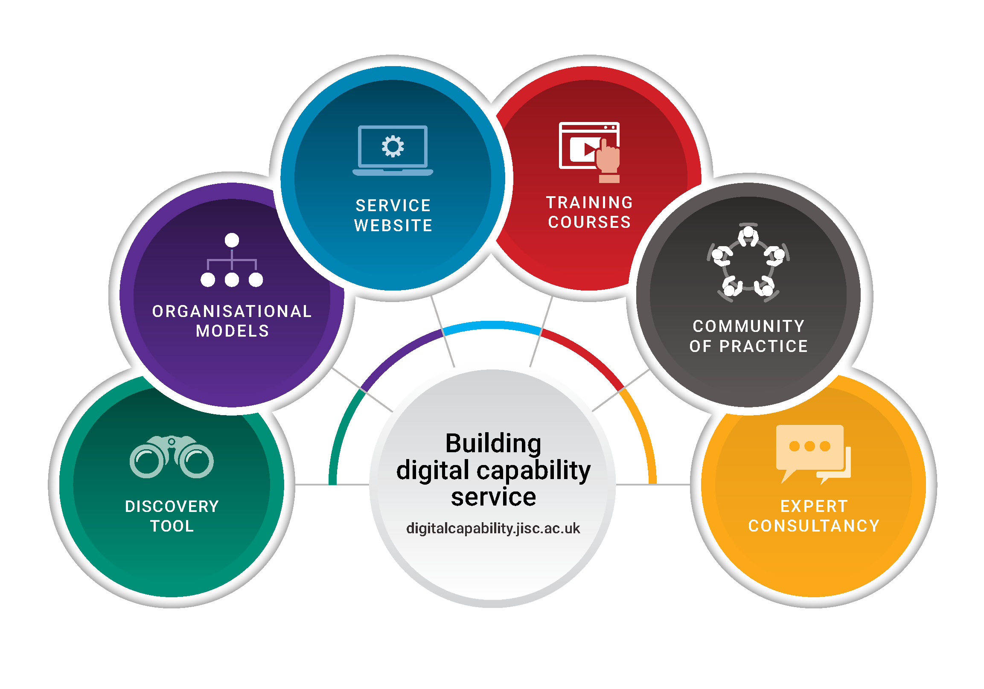
Building digital capability service
Find out more at: https://digitalcapability.jisc.ac.uk/
Notes:
We are now working with all UK educational organisations to support all aspects of building digital capability – through our Building digital capability service.
The Building digital capability service launched last October to subscribers, and offers a suit of practical tools and guidance to support UK educational organisations with all aspects of building digital capability. We’ve focused it around:
how we can support from an individual perspective your staff and students to develop their capabilities and identify their strengths and weaknesses through the discovery tool;
and from an organisational perspective support in your organisational journey to digital capability, and through the data from the tool help to provide you with indicative data on where your staff and students are.
And we’re continuing to work with universities and colleges in partnership to explore your needs and how we can best support you in that journey.

Slide 8
Introducing the Jisc digital capability framework

Slide 9
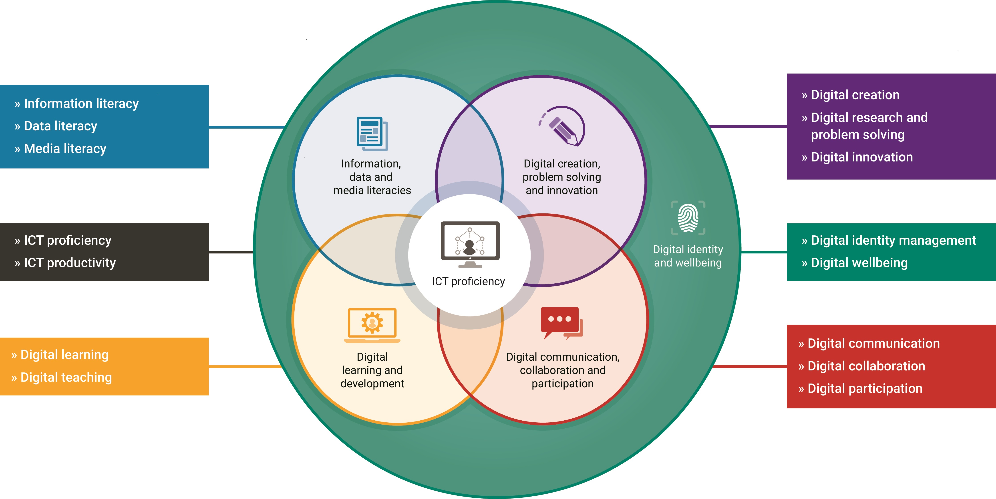
Developing staff and student digital capability
Notes:
So what are digital and how we can ensure students are developing these essential skills.
Our work in this area began in 2008 (with the Llida study reviewing learning literacies), and the Dig lit programme (2011-2013). This research led to the development of the Jisc six elements of digital capability framework. It has been influential across the sector in informing how we describe and understand what digital capabilities are and is now underpins all our developments in the Building digital capability service.
It starts from the perspective that digital capabilities are those that enable an individual to live, learn and work in a digital society.
It provides one way of thinking about staff and student digital capabilities. It provides a single, generic description that everyone can relate to. It has been influential across the UK and further afield as a common language to further explore what this means for staff and students.
It encompasses high level capabilities – around digital identity and wellbeing which focuses on developing your personal and professional identities;
4 core digital practices in the centre around communication and collaboration; teaching and learning; digital creation and problem solving; and information and data & media literacies.
And the functional ICT skills which fall out of those higher level discussions above.
We’ve been working with others including Microsoft, Google, Linkedin Learning and others to map their resources to the framework, as a way of aligning development opportunities with this model.

Slide 10


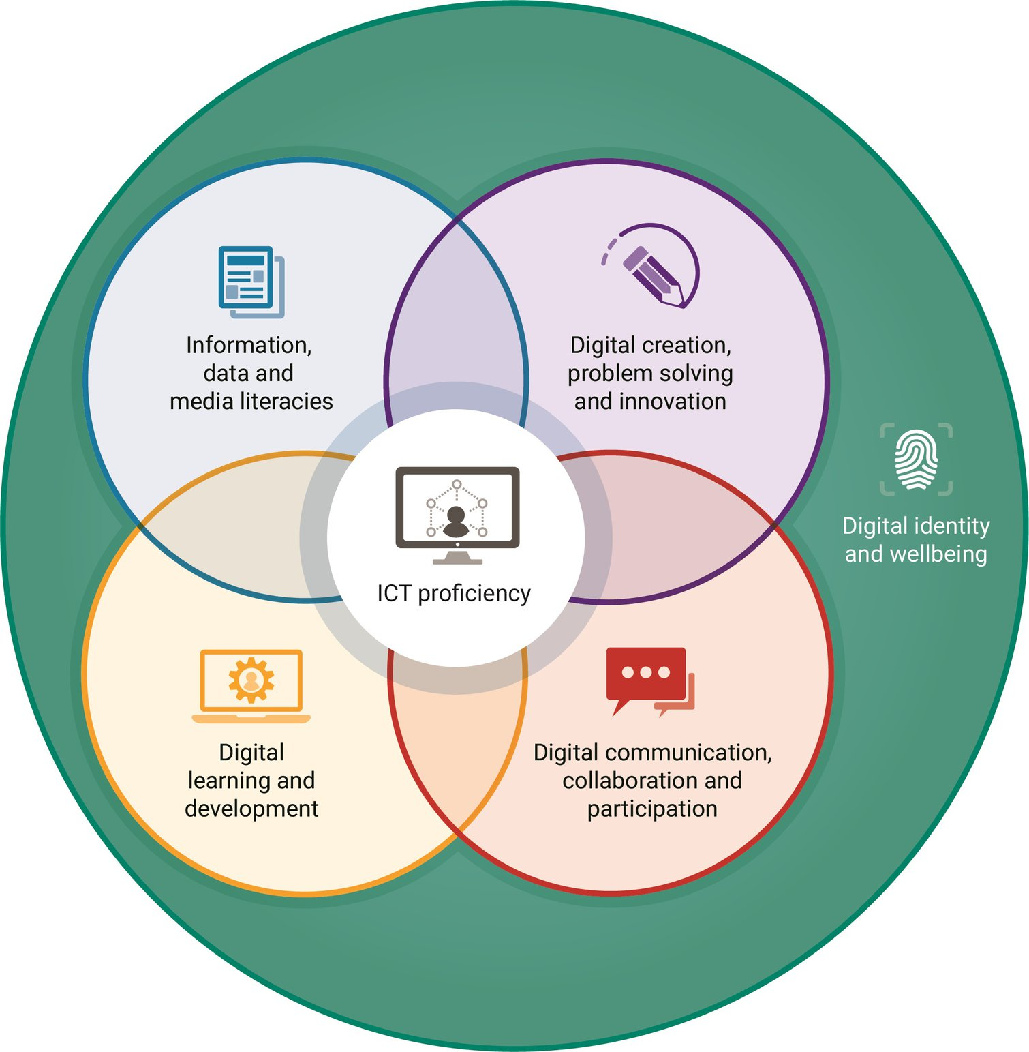

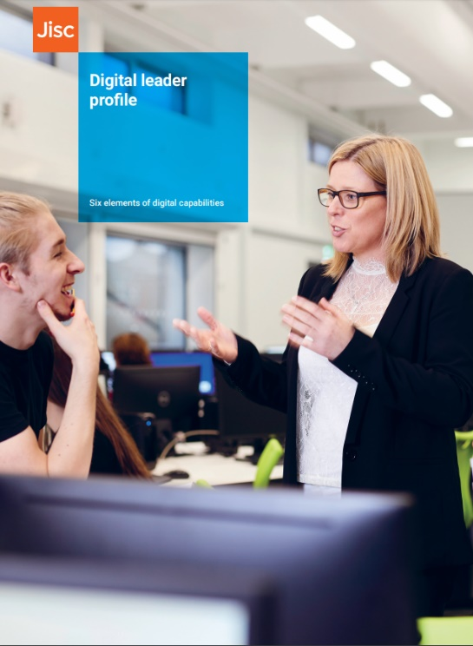

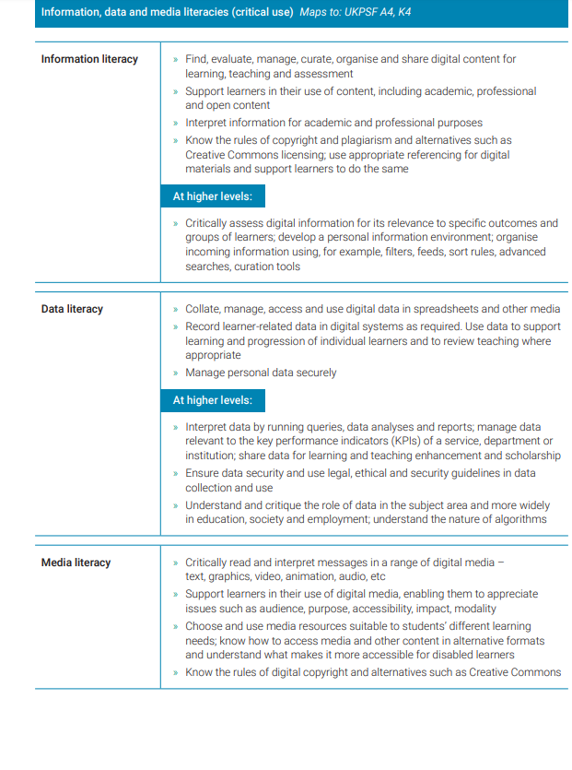
Contextualising the framework
Notes:
But we know that people don’t set out to become ‘digitally capable’ in a general way. They set out to learn a particular subject, to research a particular topic, to achieve particular tasks, to work towards particular goals in their career. So the framework has to be adapted to make sense in very different settings.
We have explored the framework from the perspective of different staff roles. These profiles aren’t meant to suggest that ALL staff in particular roles, or learners, need ALL or ONLY these skills, but they can provide a useful starting point for conversations for example across a team to agree what skills might be needed, or the identification of any gaps.
We have 9 profiles all together – each have been designed in collaboration with the relevant professional body mapping to the relevant professional framework - for example the HE teaching profile aligns with the UK PSF
HE teacher profile mapped to UKPSF
FE teacher
Digital leader
Library and information professional mapped to CILIP PKSB
Researcher mapped to RDF in collaboration with Vitae
Learning technology mapping in collaboration with ALT
Learner
Professional services staff
Research manager/professional
Our learner profile also seeks to articulate the sort of skills that could be needed by learners, and could be taken a step further in considering a subject / curriculum perspective.

Slide 11
Introducing the discovery tool

Slide 12
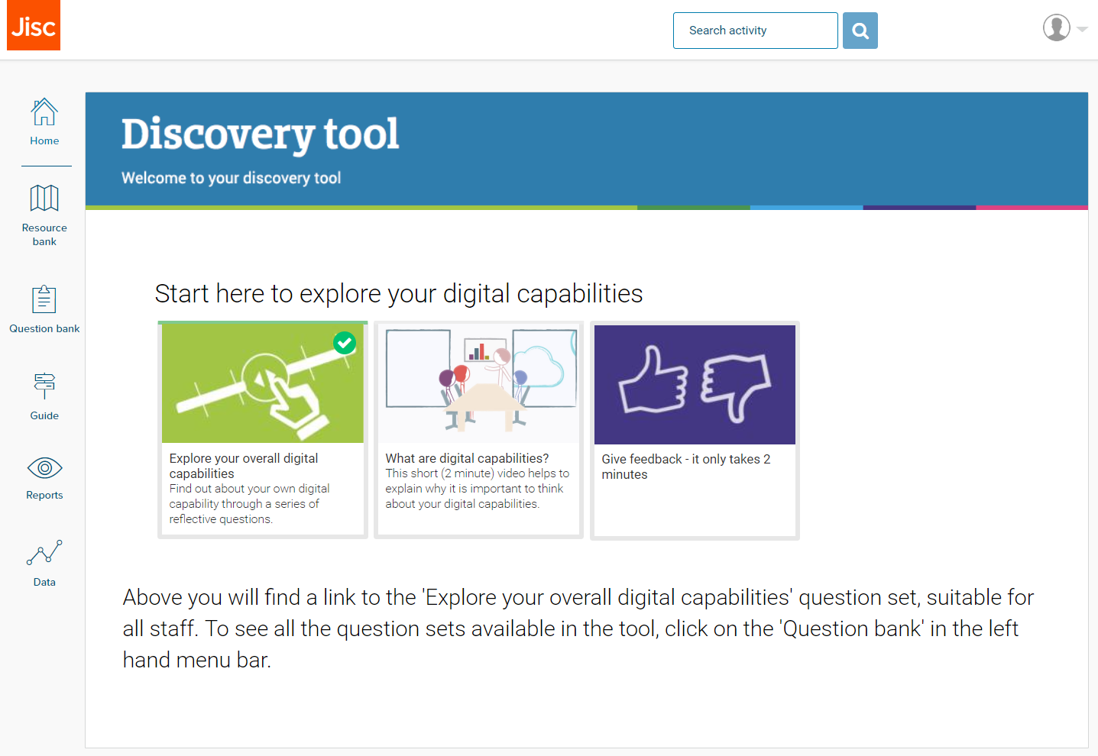
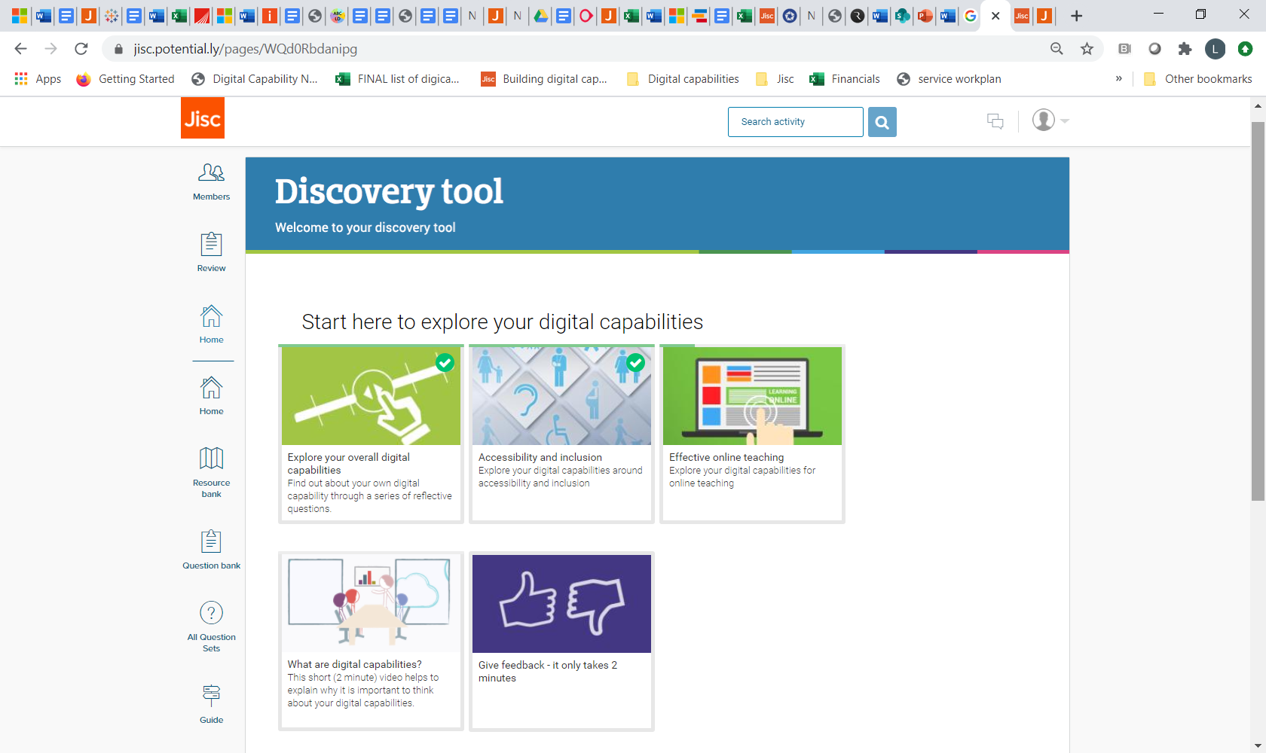
A starting point for staff and students: the discovery tool
The Discovery tool
A self-administered quiz about professional digital practices (in education)
Designed to give useful feedback including 'next steps' and links to resources
Reflective, informative and developmental
jisc.potential.ly
Notes:
So we have a shared understanding of what we mean by digital capabilities, and ways of contextualising that language for different purposes. But how do we know where staff and students are in terms of their digital skills? And how can we identify actions for development? And from a curriculum perspective, what digital skills do staff need to support a digital curriculum?
This was the starting point for the development of a tool, the Discovery Tool - following a process of co-design with other sector bodies, which provides a way for staff and students to self-assess their skills, and understand their starting points.
It provides a series of reflective questions that relate to the different elements of digital capability we have defined in the six elements of digital capability model (organised by the 15 sub-elements). Buy answering the questions staff are made aware of the skills they already have and new ones they might like to try.
As it’s designed to be primarily a developmental tool, to help support staff and students explore their personal levels of confidence and capability - it is NOT an objective measure of digital competence, and isn’t designed to be a full course of study – instead it provides a range of pointers to relevant resources.

Slide 13
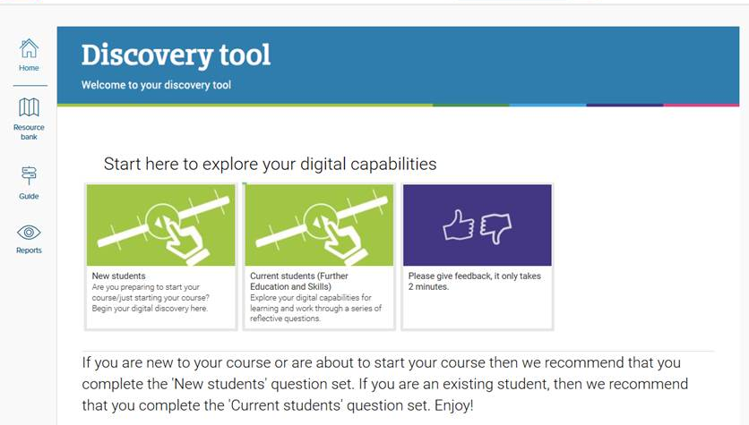
Dashboards – staff and students
Staff Student
Notes:
We have two dashboards, one for students and one for staff.
Staff and students can access the main questions designed for them from here, see a background video on what is digital capability and access to reports etc down the left hand bar.
On the staff dashboard, other role specific q’s can be found in the Question bank.

Slide 14
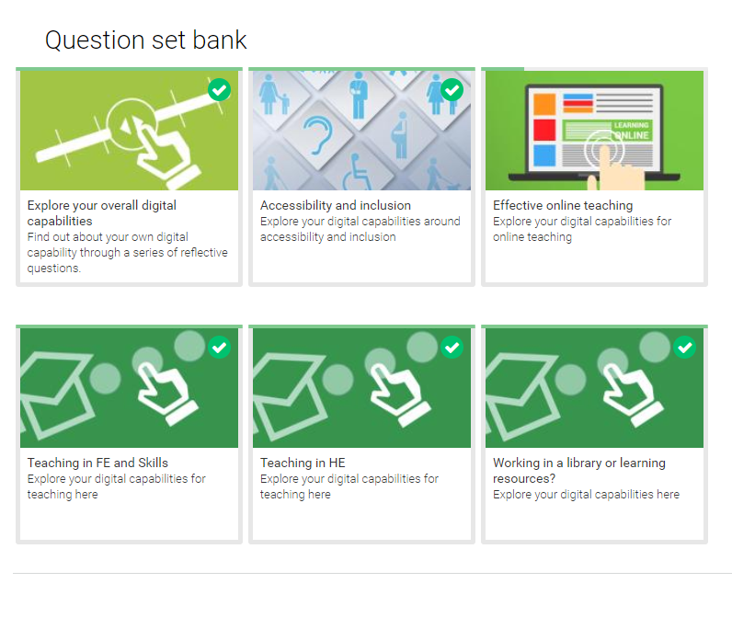
Question bank
Notes:
In terms of the questions sets available - we have one ‘overall’ question set which is suitable for staff in any role; as well as specialist questions around particular roles, or topics eg teaching in higher or further education, library and learning resources, accessibility and inclusion, and effective online teaching. These are available from the question bank link on the left hand side.
And for students, two sets from the student dashboard; for new and arriving students which is aimed more at identifying support needs for incoming students; and current students familiar with their courses of study where a new section was added to start students thinking about skills for work.

Slide 15
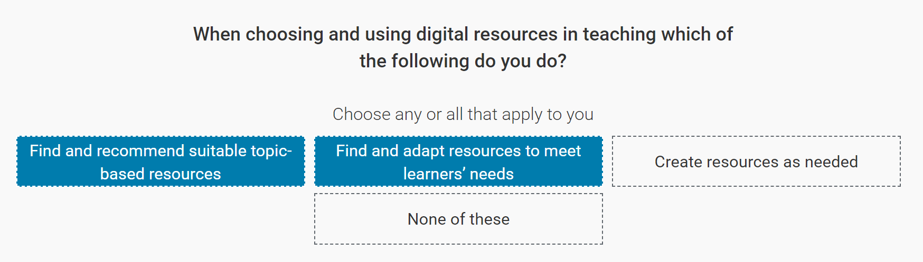
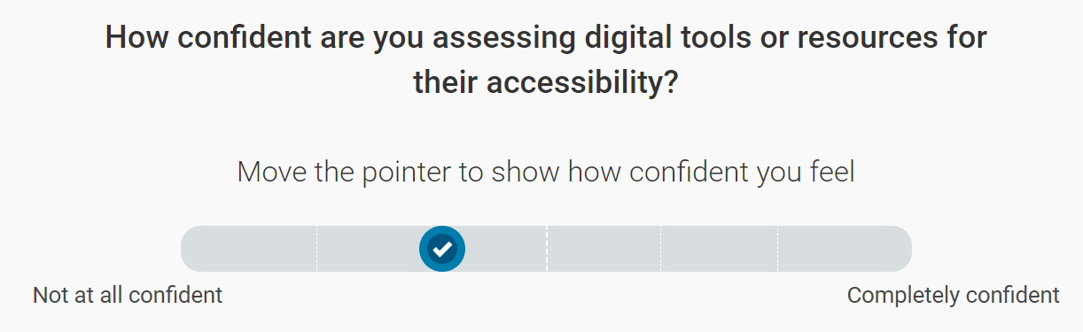
Each question set has two question types:
1
Activity (grid)
2
Confidence
Notes:
Each question set has two main question types for each element covered. These are:
Activity (grid) questions where users select all the statements that apply to them AND
A confidence question where users move a pointer to show how confident they feel about that particular element
The question types are arranged slightly differently depending on the question set – the smaller role specific question sets have more depth to them with 2 activity/breadth questions per element to explore a broader range of activities, and the larger ‘overall’ capability question set has just one activity question per element.

Slide 16
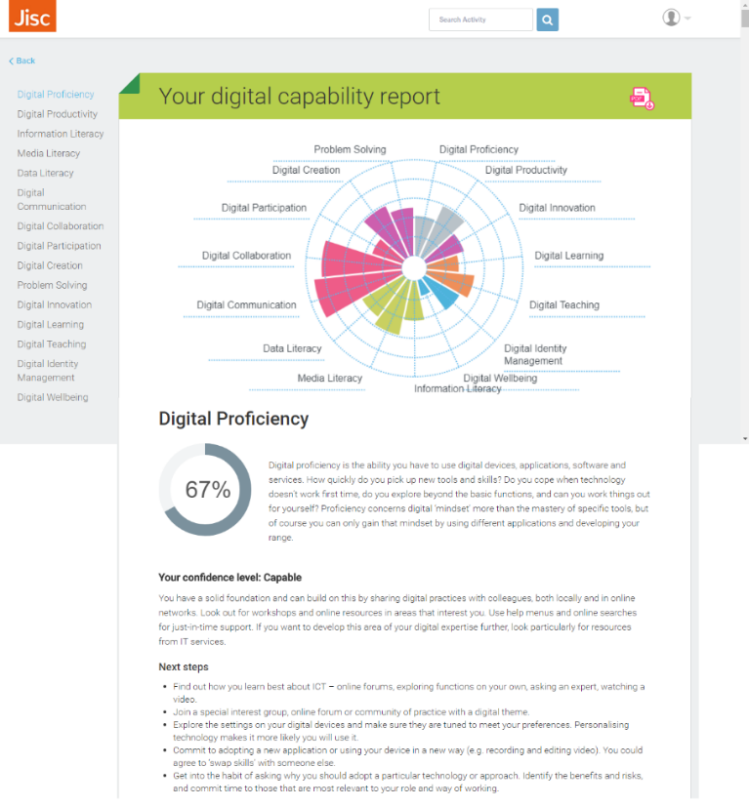
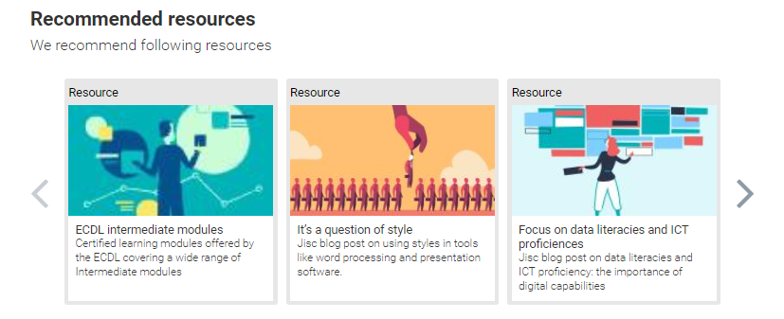

Individual report
Each element has:
Level: developing | capable | proficient
Next steps: what people at this level can try to develop further
Resources: links to selected resources for further exploration
Option to request a digital badge on completion of each question set
Notes:
Once a user has completed all the questions within a question set they are provided with a tailored feedback report. This example shows what a users of the full discovery tool receive. So, for each element they are given:
Their confidence level rating (developing | capable | proficient)
Suggested next steps
And recommended resources – all freely available; and prioritised for value in each area.
Users can download their report and share it if they choose to.

Slide 17


Ability to surface local resources
Resources added by institutions to feedback reports
Notes:
We have also the ability for institutions to surface their own local resources through the user reports and resource bank.

Slide 18
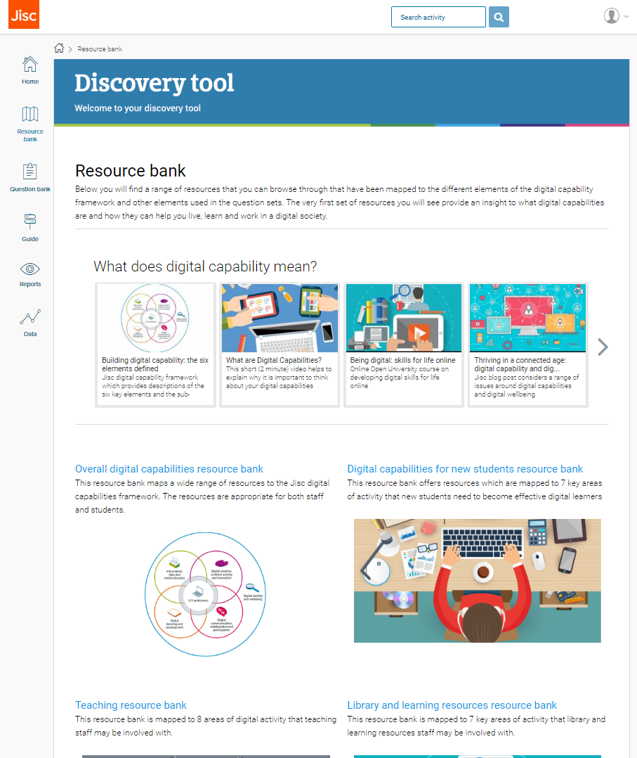
Resource bank
Notes:
The tool also has a resource bank where users will find the full range of resources that they can browse through which have been mapped to the different elements of the digital capability framework (and additional elements).
Within the resource bank there are sections that provide collections of resources for new students, teachers and library staff; on accessibility and inclusion and effective online teaching. Along with resources suitable for all staff and students in the overall digital capabilities and what does digital capability mean collections.
You can also find collections of resources in the discovery tool by publisher, for example Google, Microsoft and the Education Training Foundation (ETF).

Slide 19
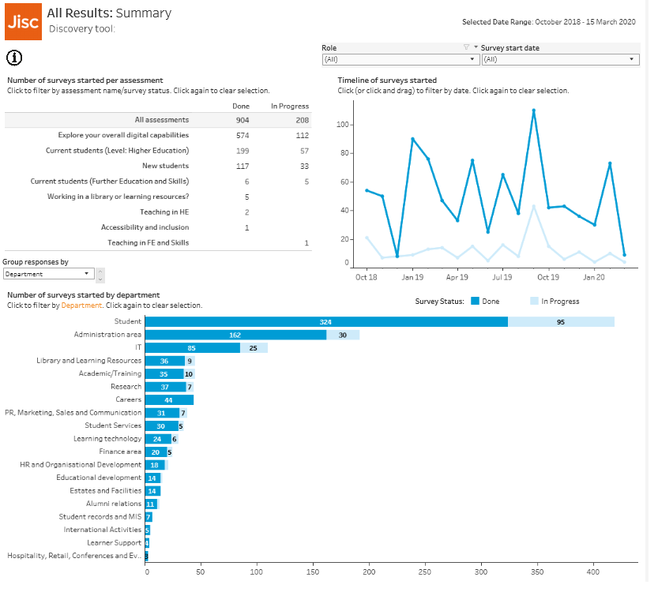
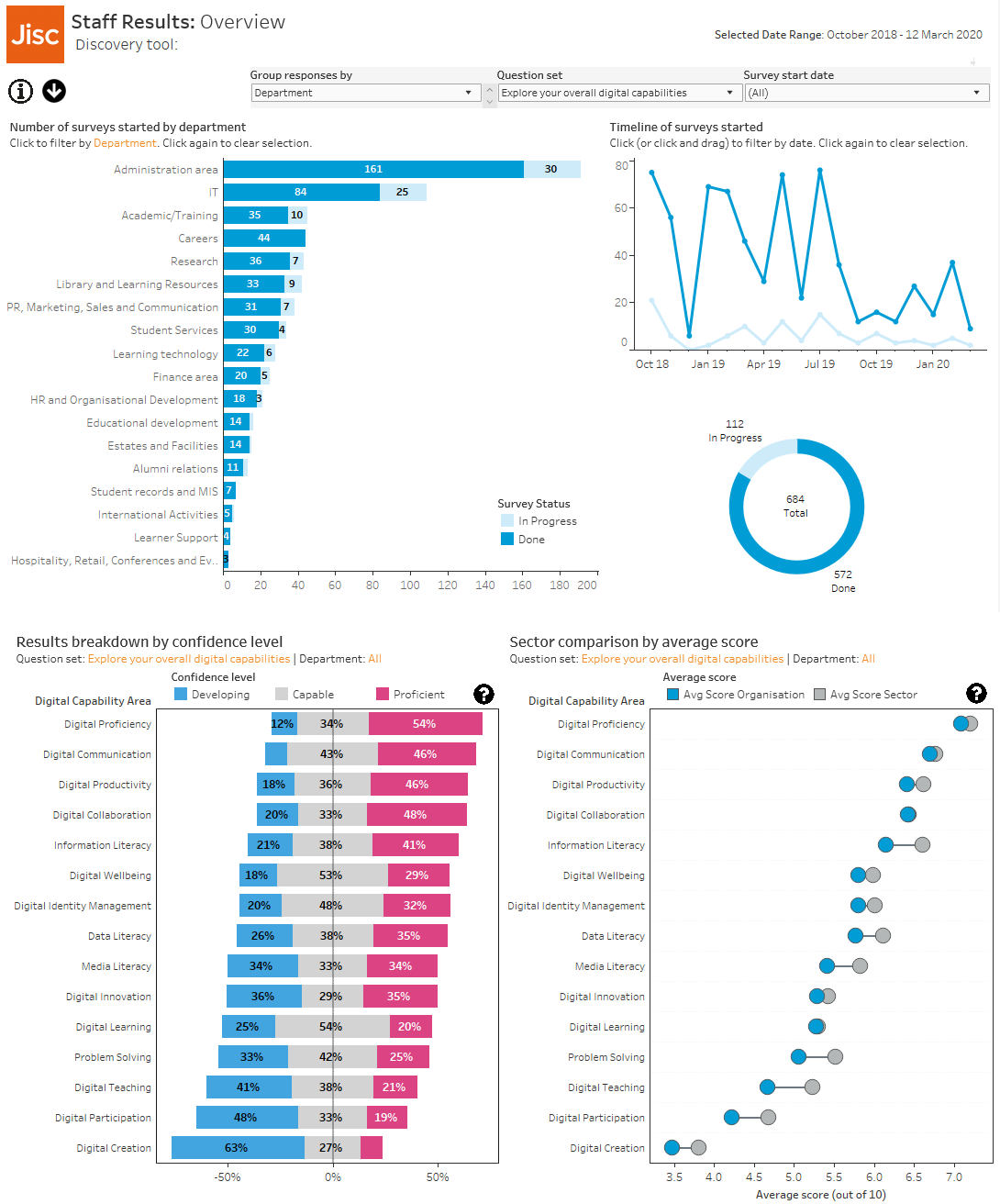
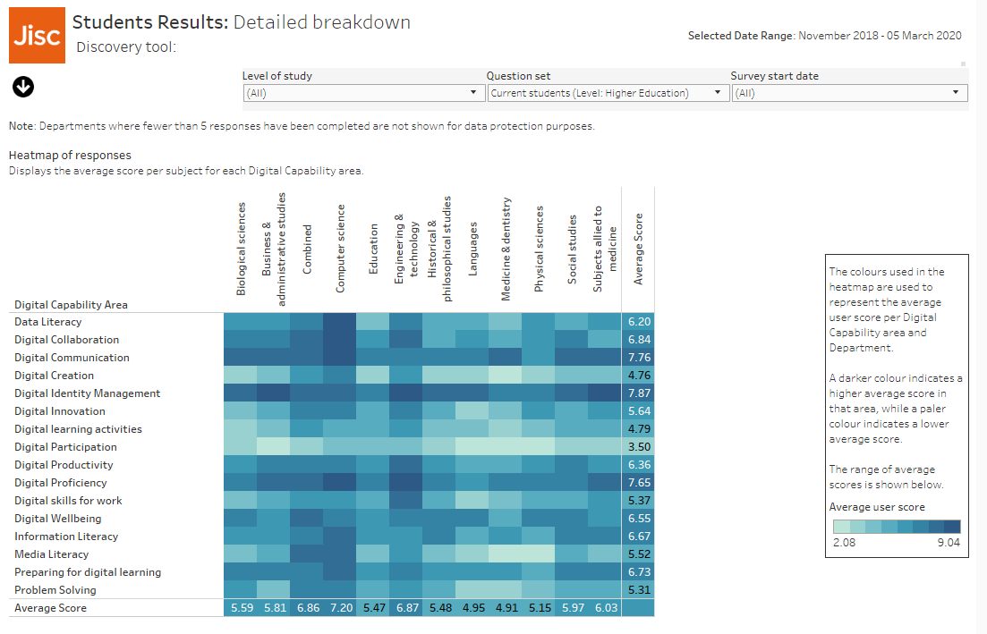
Institutional data dashboards
  Number of completions (total and by department**/ subject area*
  Digital capability scoring bands (by organisation, department**, subject area*)
  Detailed heatmap provides % grid/activity question set responses (you can see the most/ least popular choices by your staff and students)
  Sector comparisons for digital capability scoring bands
  *based on a fixed list
  *staff only
Notes:
Although has primarily been designed as a developmental tool, it does also provide anonymised data to institutions to support organisational planning for example where training could be most effectively targeted. These dashboards including data on completion rates, and capability ratings that can be broken down by dept & subject (for staff) and subject (students)
Care needs to be taken around how this data is used – we have guidance to help institutions make sense of their data
Scoring bands needs to be used with caution – as lower scores don’t necessarily mean ‘deficit’
Mainly useful for informing conversations:
With HR and staff development about overall training and development needs
With teaching staff about their confidence with digital teaching, learning and assessment and their development needs
With IT and e-learning teams about support for specific systems and practices
With budget holders about investing in staff development and services

Slide 20
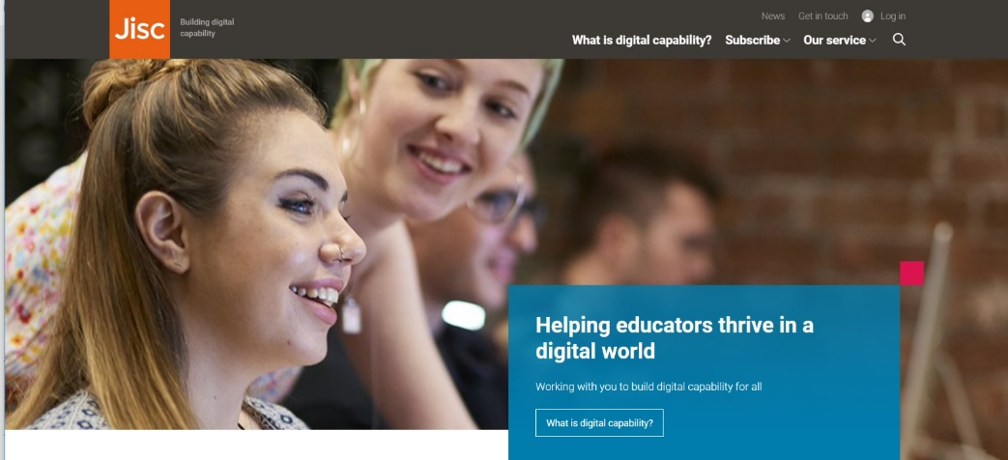
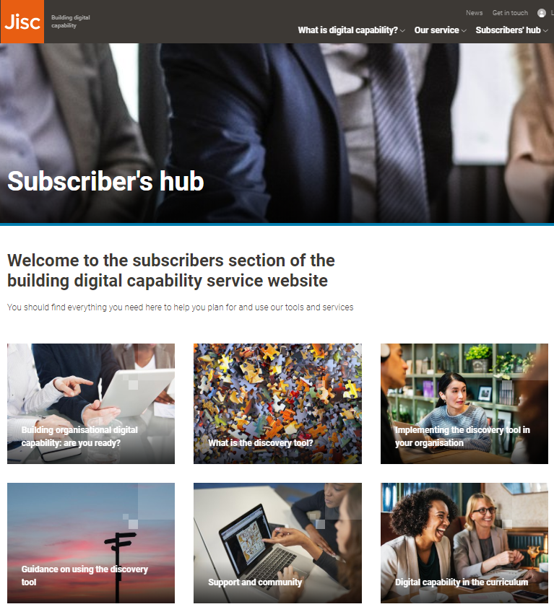
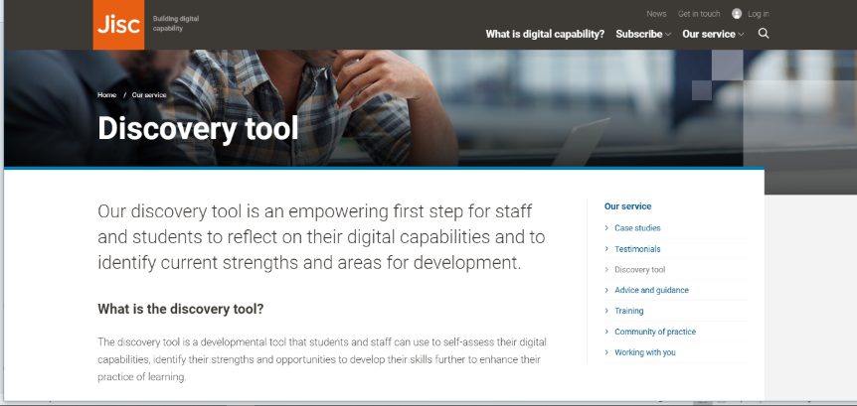
Service website
digitalcapability.jisc.ac.uk
Notes:
Our service website provides a range of supporting advice and guidance - it is designed to help you to find practical advice and guidance, whether you are leading digital change, supporting others (staff or students) to develop their digital capabilities or are simply interested in developing your own.
Here you will find guidance on implementation, user guides, download copies of the question sets in the discovery tool questions and how they are designed, frameworks, role profiles and other useful information.

Slide 21
Perceived levels of benefit of the discovery tool
Staff
Learners
Notes:
In 2018 we piloted the tool with over 100 organisations across Higher and Further Education including overseas institutions, and evaluated their experiences.
We had over 4,800 staff completions of the tool, made up of:
1352 Futher Education and skills
3042 HE
418 Other
And 413 students. The completions for students lower as this feature only came online near the end of the evaluation period.
These completions were from 66 institutions (for the staff pilot), and 11 institutions (for the learner pilot)
The findings were overall very positive – with 97% staff and 90% of students identifying benefits: either some / beneficial or very beneficial.
This aligned with 94% of organisational leads identifying benefits.

Slide 22
Discovery tool benefits: staff and students
“I enjoyed using it. The report accurately recorded my strengths and weaknesses”
“I thought the data and insights it provided just based on a quick assessment was really good”
“Made me think about things in more detail, and actually assess responses”
“[I’ve] shied away from this area, so having an abundance of help/ feedback was great”
“Did give me an idea of specific areas which would be worth working on, targeted action”
“Really useful, and I particularly like how it is relevant to skills for both my course and my future career”
Notes:
And these quotes highlight the main benefits found by staff and students; They liked the:
opportunity to stop and reflect
insights into their strengths and weaknesses
targeted suggestions
And they saw the relevance to future workplace

Slide 23
Perceived levels of benefit of the discovery tool to organisations

Slide 24
Building organisational digital capability

Slide 25
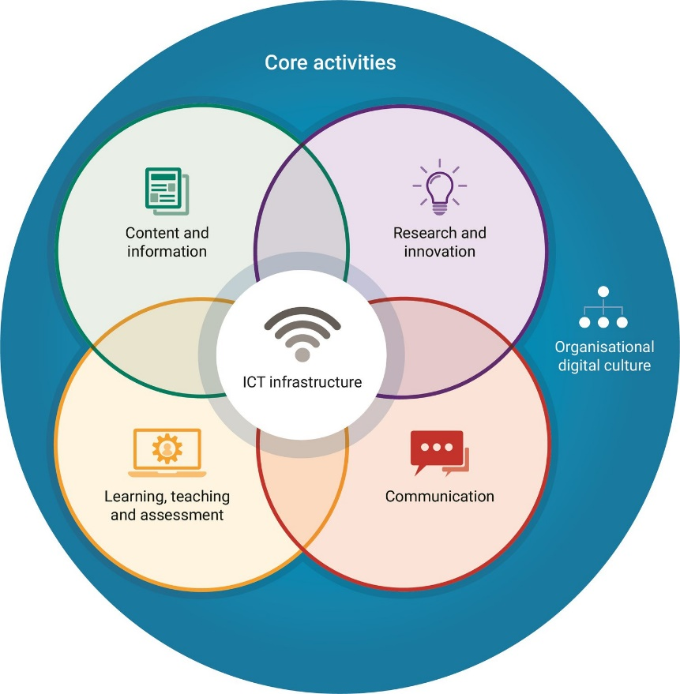
Developing organisational digital capability
‘The extent to which the culture, policies and infrastructure of an organisation enable and support digital practices.’
Helen Beetham (2017)
How is your organisation developing its organisational digital capability?
Jisc 2017 model
CC BY-NC-ND
Notes:
So we’ve talked about digital capabilities from the individual perspective of staff and students; but if we’re truly to move towards enabling our students to thrive not just survive our organisations as a whole need to develop their cultures, policies and infrastructure to enable and support digital practices.
I’ll spend my last few minutes touching on this.
This image is a model that sought to consider digital capabilities from an organisational perspective rather than individual– and highlights with the middle circles 4 core activities across the organisation – and from their perspective how they need to be considering the digital agenda. With organisational culture encompassing all.
We’ve worked this up into a practical maturity model for organisations – with indicators of practice at different levels based on some of the success factors we’ve been discussing around for example considering approaches to recognition and reward for skills. The model has templates for you to work with to help you self-assess where your organisation is in relation to becoming a digitally capable organisation.

Slide 26
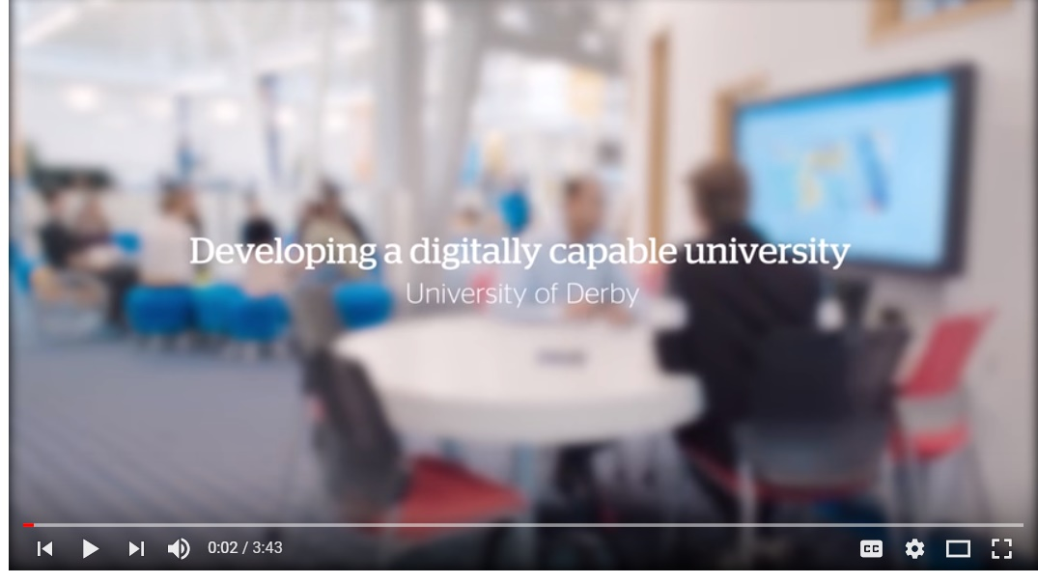
What are organisations doing in this space?
Key success factors
Common vocabulary
    How is this communicated?
Strategic support
    Stakeholder group
Engaging HR
    Recruitment, appraisal etc.
Developing staff and students
    Reward and recognition
Building digital capability into the curriculum
Working in partnership
https://ji.sc/digicap_films
Notes:
Organisations are all at very different stages on this journey towards digital capability, many at the very beginning.
Some of the key success factors relate to:
A common vocabulary - is there a common understanding of digital skills across the organisation?
Leicester built their own framework based on the Jisc model, but contextualised to fit their needs.
Does your organisation have a strategy which articulates your vision for developing a digitally capable organisation & is there a strategic lead?
See Leicester case study
Does your organisation have a stakeholder group which meets regularly to steer/advise on digital capability? Who is on that group and does it include key stakeholders from all business areas (e.g. HR, IT, estates, staff development/educational development, library, academic staff, student facing services…careers)
See Hertfordshire case study
Have you engaged HR in considering how digital capabilities are embedded within their practices (eg recruitment, induction, appraisal)
Institutions starting to have these conversations – including York St John, University of Derby. We ran a study which explored these processes in more detail.
Are the benefits clear to staff and students? How are these benefits being communicated?
See our poster templates to help support a communications plan
Do you have a culture of encouraging, recognising and rewarding innovation?
And how are you building digital capability into the curriculum.
Are digital outcomes embedded in your graduate and programme level outcomes? Are digital activities enabling those outcomes as part of the curriculum?
Our Curriculum confidence approach might help
And building on the strengths of all your stakeholders to work in partnership? We’ve much evidence of the value of student / staff partnerships though our Change Agent Network.

Slide 27
Identifying good practice principles
Jisc 2017 model CC BY-NC-ND
Notes:
Based on the success factors I have just outlined and the Jisc organisational digital capabilities model, we have developed an organisational maturity model which is an action oriented benchmarking tool to support organisations to self-reflect on where they are on this journey and where they may choose to develop further.
On this slide you can see the set of high level ‘good practice’ principles for the six functions identified in the organisational model.

Slide 28
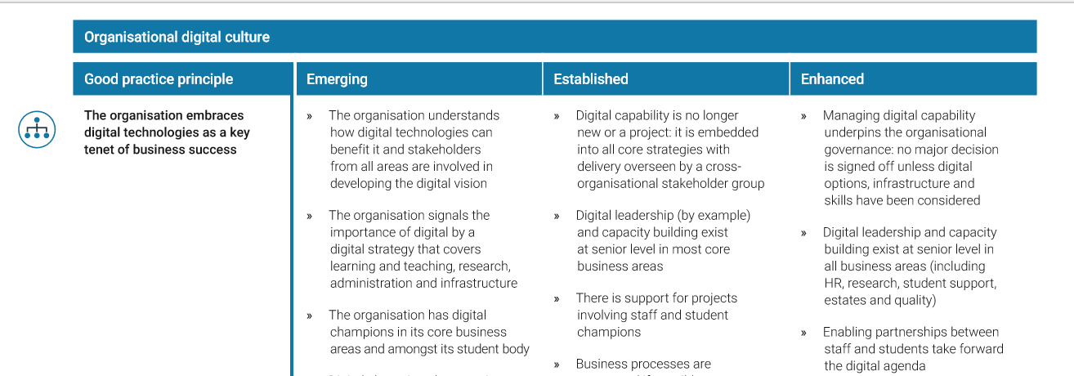
Examples
Notes:
For each good practice principle we’ve identified indicators of practice.
The principle that the organisation embraces digital technologies as a key tenet of business success – includes indicators around:
Development of a digital strategy that covers all core functions - L&T, research, admin and infrastructure
The importance of a cross—institutional stakeholder group leading digital capability across the organisation
The importance of partnerships between staff and students around building digital capability
These indicators can contribute to the development of a culture that enables digital practice

Slide 29
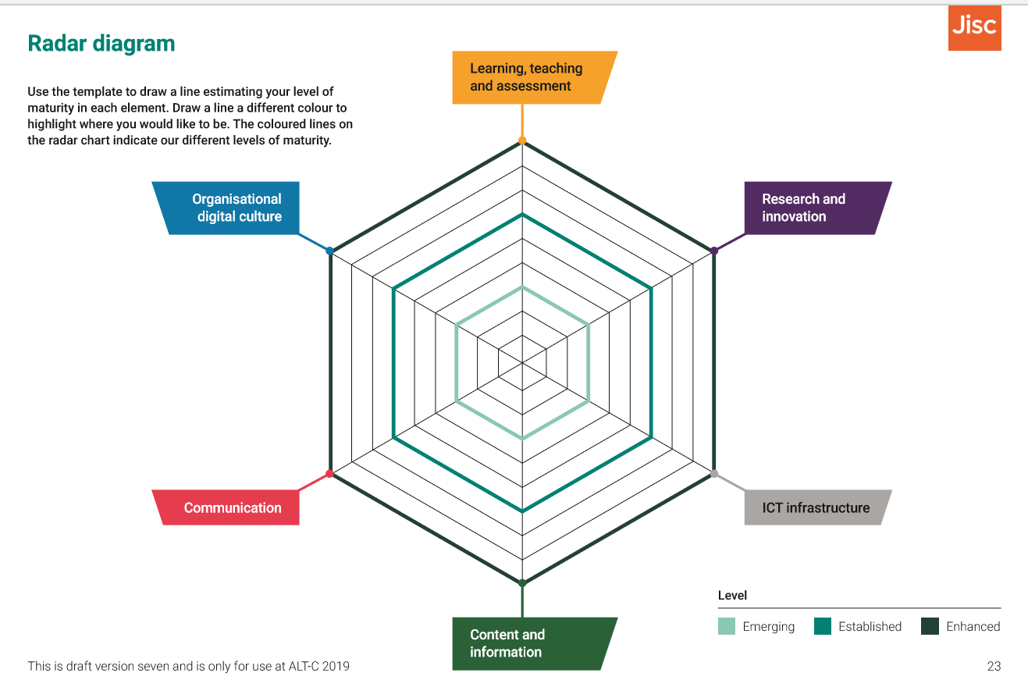
Where are you on your journey?
Notes:
As part of the organisational maturity model we have developed some templates to support organisations in reflecting where they are in their journey – supporting them to identify their strengths and areas for improvement – this radial diagram provides a template for organisations to plot this in a diagrammatic form.
We’re also developing an interactive version of the tool for us to use when working in consultation with the community – to provide suggested actions, resources, and examples of practice following a self-assessment. The ultimate aim is that this will be available online for subscribing institutions to use on a self –serve basis.

Slide 30
Implementing the discovery tool

Slide 31
Implementing the discovery tool
Decide what will work in your setting…..
Then plan, prepare, engage, communicate
Consider your organisational context
  Drivers, senior leadership, who benefits?
What does ‘success’ look like?
Engagement and communication
  Staff and/or students? How will they be targeted?
  Clearly identify the benefits
Support and follow up
Evaluation and impact
Notes:
Your organisational context
What are the most important strategic drivers for developing digital capability?
Are there any special project(s) or initiative(s) that provide a context for the discovery tool implementation process?
Who is responsible for leading and building digital capacity across the organisation? Have they all been included in your discussions with Jisc?
Who will benefit from the discovery tool implementation and what do you anticipate the benefits will be?
What support is available to staff and/or students
How are digital capabilities integrated into the curriculum (e.g. with a mandated framework, graduate attributes, plug-in modules etc)
What are the most significant opportunities to develop digital capabilities in your organisation? » What are the most significant threats to the organisation if digital capabilities are not effectively supported?
What will ‘success’ look like for your implementation of the discovery tool?
Consider staff numbers and roles, completions, follow-ups, possible impact.
Engagement and communication
How many staff will be targeted and in what roles?
How will communications be designed and delivered?
What key stakeholders are engaged and how are they championing the tool
How have the potential benefits been communicated to staff?
What reward or recognition (if any) is offered to staff for engaging with the discovery tool?
Support and follow-up with staff
In what setting(s) will staff complete the discovery tool?
What support (if any) will be available in those settings?
What support (if any) will be available to help staff review their personal report and action plan?
What resources (online or f2f) are available to help staff develop their digital capabilities? How are these being signposted?
What opportunities are provided to encourage further regular and ongoing review and reflection?
Evaluation and impact
How do you plan to use the data returns from the discovery tool?
How else are you evaluating the benefits and impact of staff using the discovery tool?

Slide 32
Engaging staff and students
General Principles
Establish the voluntary and private nature of participation
Explain the individual benefits
You could also mention organisational benefits
Send out clear messages in a range of media, ideally with endorsement from staff and student bodies as well as senior stakeholders
Find engagement opportunities and settings that fit in with existing practice and presence
Ensure there is suitable student support in place, so users understand what’s expected, feel supported as well as challenged, and can plan any follow-up activities
Consider the touch points going forward where the tool could inform ongoing developmental conversations
Notes:
So finally I wanted to share some of the lessons we’ve learnt around how to get most value from the tool if you’re considering using it with students, here are some of the princicples:
Establish the voluntary and private nature of participation
Explain the individual benefits – both in general, by having a safe space to explore digital practice, and in your particular context, eg by linking the discovery tool to other opportunities
You could also mention organisational benefits, eg better planning and targeting of resources to support staff and students with their development
Find engagement opportunities and settings that fit in with existing practice eg for students in lessons with their tutor or lecturer for support and dialogue; or timetabled workshops or drop-in surgeries
Send out clear messages in a range of media, ideally with endorsement from student bodies as well as senior stakeholders for example, principal or pro-vice chancellor
Ensure there is suitable student support in place, so users understand what’s expected, feel supported as well as challenged, and can plan any follow-up activities:
opportunity to share and discuss results
opportunity for further action planning around the reports
links to local resources/development opportunities (you can do this through the tool)
completion in live, supported, f2f or online settings
tailored training mapped to the content of the discovery tool
Consider the touch points going forward where the tool could inform ongoing developmental conversations, e.g tutorials, careers conversations, induction, employability modules or pathways

Slide 33

Engaging students
Some ideas for working with students:
In existing learning groups
In the context of a timetabled workshop
As part of a co-curricular award
We don’t recommend using the tool with students in a completely self-directed setting unless this is for a confined group of confident users
Universities are exploring using the tool as part of:
Pre-arrival and induction
Tutorials
Career conversations
As evidence to inform departmental planning
Notes:
The setting in which users meet the digital discovery process is important to establishing trust and encouraging engagement. Some users will feel safer in a peer-group setting, while others will prefer complete privacy. You may want to offer both options.
Some ideas for working with students are:
In existing learning groups, eg as part of the curriculum, where the tutor or other specialists in digital literacy can provide information and support
In the context of a timetabled workshop where, for example, learning support, academic tutors or careers staff can lead and support the session
As part of a co-curricular award or development pathway, with support;
We do not recommend using the discovery tool with students in a completely self-directed setting unless you are confining its use to an established group of confident users such as student digital mentors or course representatives – and even then you must establish how they will access support and will support each other to complete the process and make forward plans

Slide 34


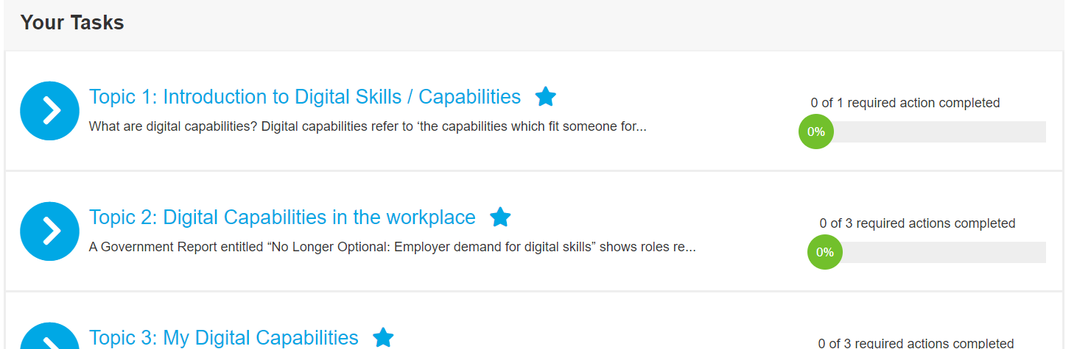
Ideas and examples
University of Derby – developed a student course:
Notes:
As of September 2020 we are now working with over 64 organisations with the discovery tool, and have seen over 19,000 users completing over 18,000 question sets.
Each organisation is using the discovery tool in a way to suit their goals and practices, but I just wanted to highlight a couple of approaches that are working well for other universities in using the tool with students.
The University of Derby have created an online course, ‘Digital skills for employment’, which is focused on getting them to think about digital skills for the workplace. Students are asked to review their skills, consider what skills might be relevant to the sector they are planning to enter, and create an action plan for improving their skills. They have embedded videos from local SME’s which provide weight on the emphasis of which digital skills are key.

Slide 35
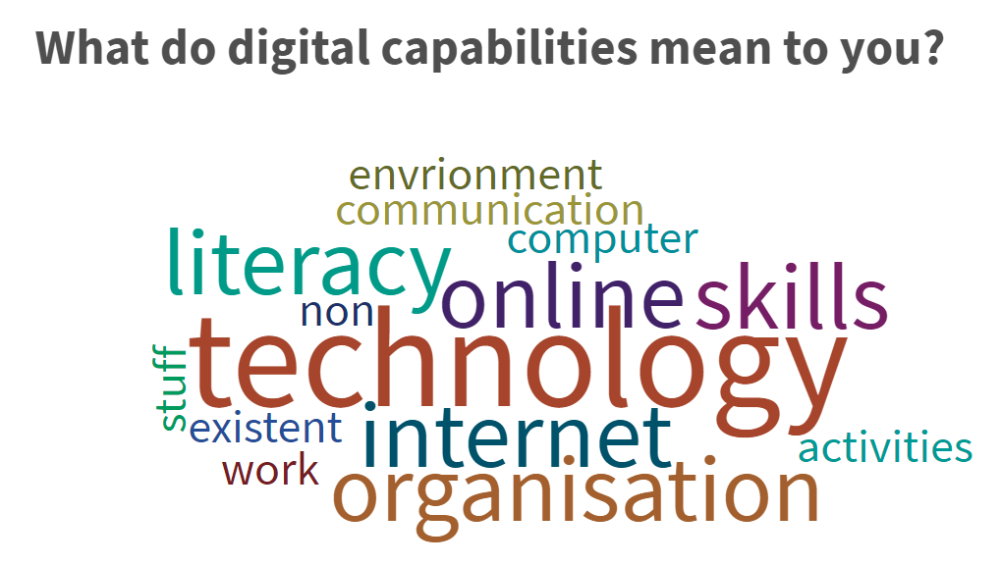
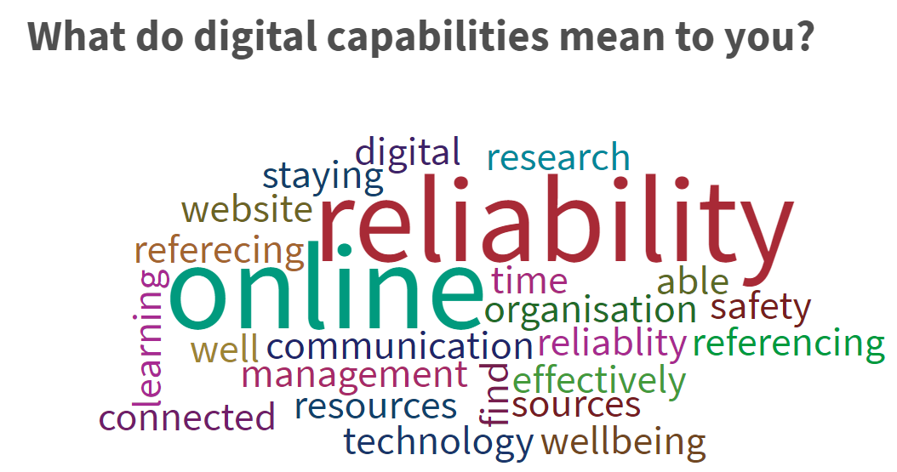
Ideas and examples
University of Surrey: activity led by student interns
What do digital capabilities mean to you?
Introduction to digital capabilities
Introduction to JISC Discovery Tool
What do digital capabilities mean to you?
Tailored Elements: Information Literacy & Digital Wellbeing
Notes:
The University of Surrey worked with a team of student interns creating and leading an online activity with bioscience students as part of their course. The session took students through a word cloud activity thinking about what digital capabilities meant to them, before and after the session to see if their understanding had changed through the course of the session.
They introduced 2 specific digital skills of critical importance in their field of study
You can see from the activity that their understanding was expanded during the discussion.
After the session they were asked to create a reflection and plan in their eportoflio.

Slide 36
Where to start….
1. Consider your whole organisational context
Explore our checklist and organisational maturity model to review where you are as an organisation
Find out about what others are doing
    Identify case studies that could help and make contact
    Use our subscriber mailing list and join our support webinars
    Join our Community of Practice mailing list and see presentations from past events
2. Plan for implementation
  Use our implementation pro-forma for prompts
  Tips in our guidance ‘Discovery tool: planning for implementation’ and ‘Engaging users’
  Consider your approach to student questions
3. Discovery tool practicalities
  Read our practical procedures and watch our recorded webinars to help you:
    log in for the first time;
    access and understand your data procedure and recording
    and add your own resources procedure and recording

Slide 37
Reflection and discussion
Consider:
How could you use the tool with your students and staff?
What support would need to be in place?
What opportunities will be provided for further regular review, reflection and development planning?
How would you design and deliver communications?
How do you plan to use the data returns?
How will you evaluate the benefits and impact of the tool?

Slide 38
Working with you

Slide 39
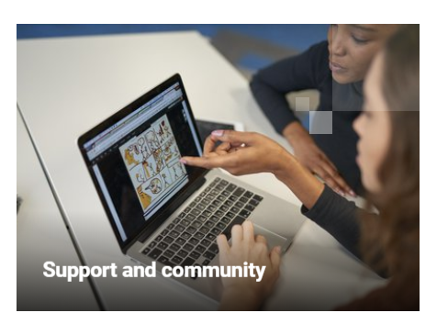
Digital capabilities support webinars
6 x yearly
Focus on different aspects of building digital capability and sharing practice
Recorded and available from our ‘subscriber’s hub’
More details:
https://digitalcapability.jisc.ac.uk/dashboard/subscribers-hub/support-community/

Slide 40
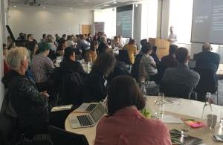
Digital capabilities community of practice
Launched in May 2017 and runs twice yearly
More than 100 participants from across Further and Higher Education
Join our Community of Practice mailing list: jiscmail.ac.uk/jisc-digcap-ug
“Valuable for inspiring new ideas and making new contacts, for sharing resources.”
More details:
digitalcapability.jisc.ac.uk/our-service/community-of-practice
Notes:
Our digital capabilities community of practice with over 100 active participants is an open community that welcomes both experienced participants and those who have not previously engaged in this field but who would like to find out more.
So if this interests you and you are not already a participant, please do join our Community of Practice. We run events twice a year in partnership with universities and colleges with the focus on sharing experiences, solutions and challenges. This, along with the mailing list provides opportunities for members be kept up to date with news and events and to work together on all aspects of digital capability for staff and students
Our next event will be taking place in November in Edinburgh, the date of which will be shared via the mailing list and on the community of practice website. We are always looking for volunteers to share their practice at these events - so do let us know if you are interested in being involved.

Slide 41

Training courses
Curriculum confidence workshop:
A designing for digital capabilities in the curriculum workshop. This is a one day workshop suitable for curriculum, library, learning technology, learning support and employability staff.
jisc.ac.uk/training/curriculum-confidence
digitalcapability.jisc.ac.uk/our-service/training-and-webinars
Digital leaders programme: The digital leaders programme will equip participants to lead the digital agenda. This is a 4 day course over two residential workshops.
jisc.ac.uk/training/digital-leaders-programme
Notes:
We offer a number of courses and workshops that are particularly relevant to building digital capabilities. And service subscribers get a 15% discount on these.
On this slide are two courses are coming up – the curriculum confidence workshop which helps you to prepare your students to learn successfully in digital settings is running at the end of this month in Glasgow and the new cohort of the Digital leaders programme runs over the 9th and 10th and 23rd and 24th of October in Edinburgh. More information on these two courses can be found via the urls on this slide
And you can find the details of all our training offers on the main url shown near the top of the slide.

Slide 42

Get in touch…
Email: help@jisc.ac.uk (with ‘digital capability’ in the subject line)
Join our community mailing list: www.jiscmail.ac.uk/jisc-digcap-ug
Read our blog:
digitalcapability.jiscinvolve.org
Join us on Twitter
#digitalcapability
Except where otherwise noted, this work is licensed under CC-BY

