Slide 1
Embedding the JISC Discovery Tool into University Culture
Patrick Turner
IT Systems Trainer

Slide 2
IT Systems Trainer
Role created around the time of the pandemic
Offering a training portfolio to support staff with the introduction of new technologies; mainly MS Teams and associated apps
Researched systems for staff to self-assess their digital capabilities and confidence
Went with JISC’s Discovery Tool
Spent time creating a layout that pointed staff in the direction of LTU resources and approved tools (internal training, guidance and external resources such as LinkedIn Learning)

Slide 3
Timeline of Key Events
Learning & Teaching Day
Performing & Developing Forms
New starter Induction Process
Data Analysis
Next Steps
Jan 2021
Apr 2021
Jun 2021
Aug 2021
2022

Slide 4
Learning and Teaching Day
January 2021
All academic staff invited to a Learning and Teaching day.
30min slot to explain the Discovery Tool, how to log in, sign up and navigate around the portal
Time scheduled in the day to complete the ‘Effective Online Teaching’ question set

Slide 5
Data Analysis
April 2021
Staff given a few months to complete the question set
Data extracted and analysed
Four areas highlighted to focus training around
IT Systems Training portfolio updated to reflect staff needs
Mapping exercise completed with LinkedIn Learning resources

Slide 6
Performing & Development Forms
June 2021
Worked with HR to add formal question to academic P&D forms (mandatory)
Introduced the ‘Overall Digital Capabilities’ question set
Asked to discuss their reports with line managers to set objectives for the following 6 months

Slide 7
New Starter Process
August 2021
‘Overall Digital Capability’ question set has also been added to the new starter process (mandatory)
Written into induction forms that are sent to new starters and their line manager
Outcomes of the Discovery Tool report used to create specific objectives for the new starter’s 6 month probation.

Slide 8
Next Steps
2022
Working on introduction of a DigiLearn programme
Progressive levels where staff demonstrate and evidence their digital capabilities within their working practices
Level 1 will require staff to ensure they have completed the ‘Overall Digital Capabilities’ question set
Launching the Discovery Tool to the Professional Services workforce
Exploring the possibility of using the Discovery Tool with students. Many things to consider first.

Slide 9
The key to successful implementation
Get leadership onboard
Create dedicated time/events for the Discovery Tool
Embed into other initiatives to highlight the importance of the tool
Keep promoting the service

Slide 10
Thank you

Slide 11
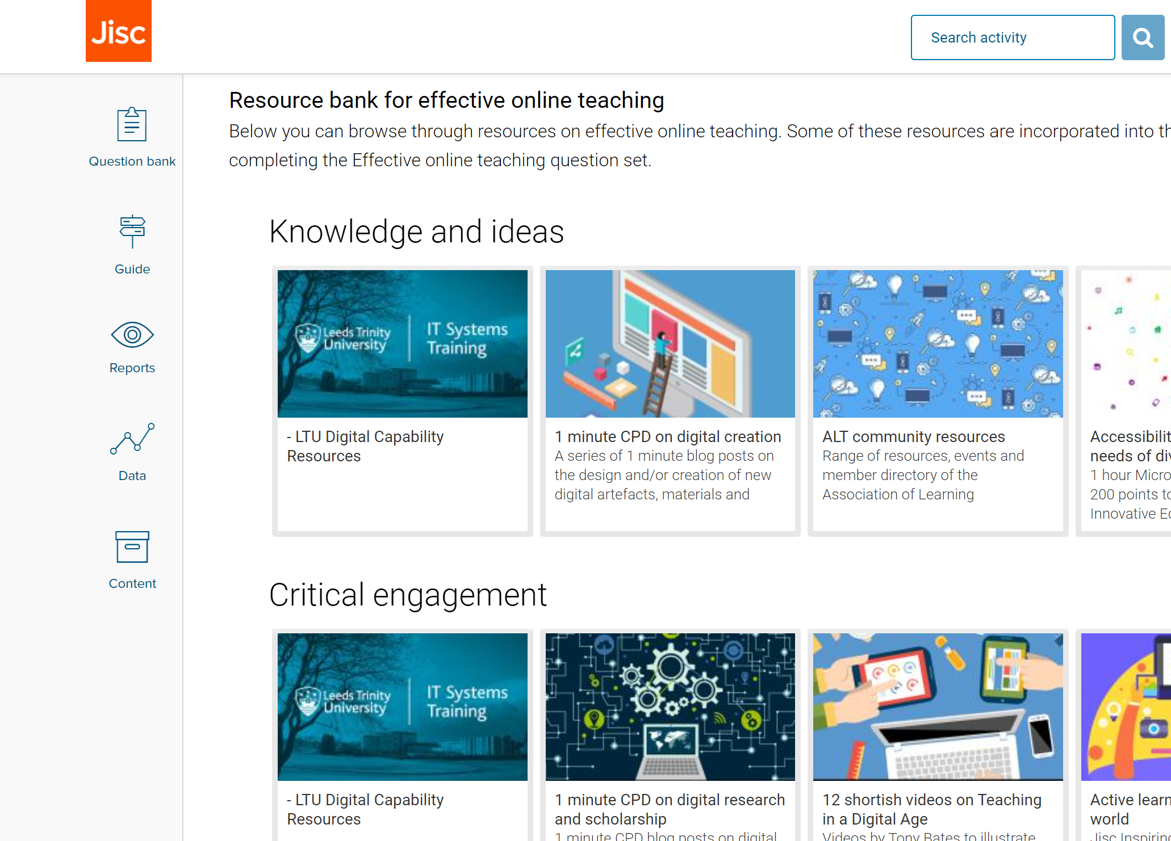
Screenshots of discovery tool

