Slide 1
Building Digital Capabilities Service

Slide 2
What are digital capabilities?
University of Derby used under licence CC BY-NC-ND 4.0

Slide 3
Digital capability is important
Our world is changing…
Changes in the digital landscape have accelerated
Changes in learner expectations
Digital capabilities are key employability skills
Employers are looking for knowledge and skills
Digital skills gaps concerning industry leaders
Over eighty per cent of all jobs advertised in the UK now require digital skills New Digital Strategy to make UK a global tech superpower 2022

Slide 4
It’s not just about looking outwards
Building digital capability is about reflection and development
Around 44% of staff were provided with guidance about the digital skills needed for their teaching role (December 2022)
Around 14% of staff were provided with an assessment of their digital skills and training needs (December 2022)
Almost 50% of students received guidance about digital skills required for their course (September 2022)
Approximately 39% of students had time to explore new digital tools and approaches (September 2022)

Slide 5
The concept

Slide 6
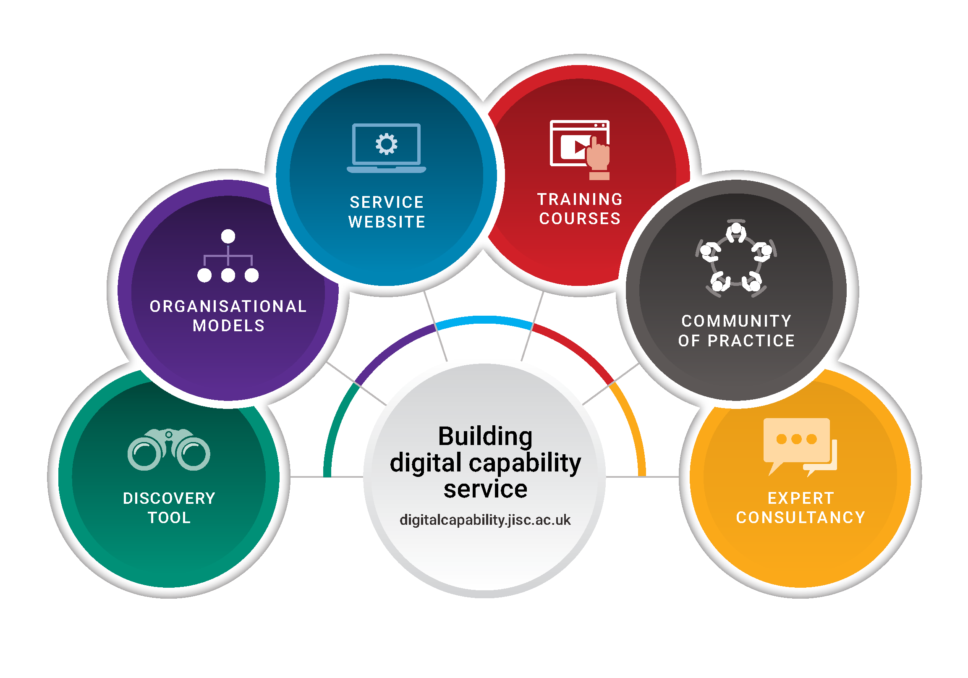
The service

Slide 7
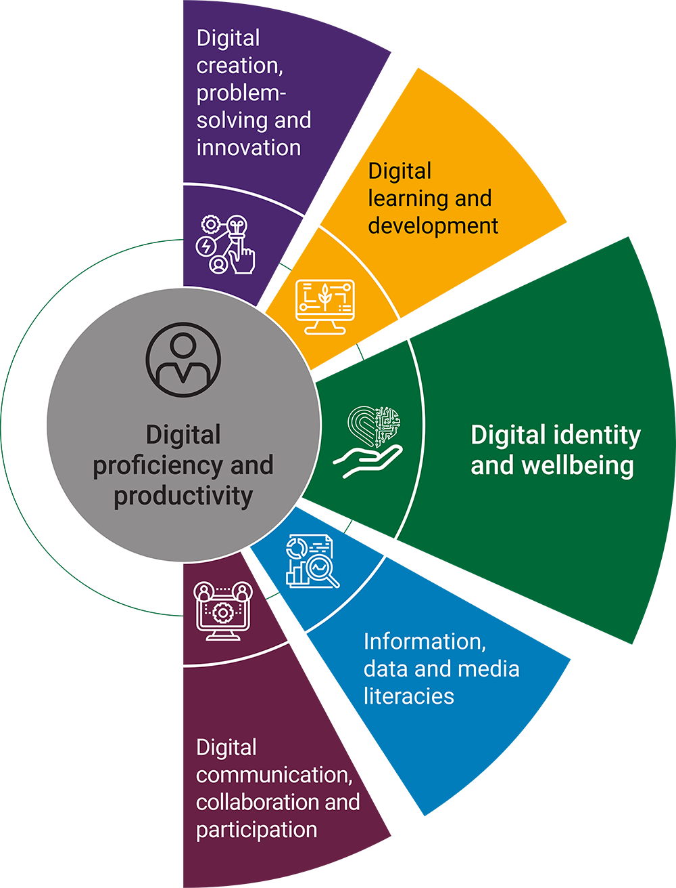
The framework
Sector developed framework updated September 2022
Digital identity and wellbeing surrounds all
Widely used framework both nationally and internationally
Notes:
So what are digital and how we can ensure students are developing these essential skills.
Our work in this area began in 2008 (with the Llida study reviewing learning literacies), and the Dig lit programme (2011-2013). This research led to the development of the Jisc six elements of digital capability framework. It has been influential across the sector in informing how we describe and understand what digital capabilities are and is now underpins all our developments in the Building digital capability service.
It starts from the perspective that digital capabilities are those that enable an individual to live, learn and work in a digital society.
It provides one way of thinking about staff and student digital capabilities. It provides a single, generic description that everyone can relate to. It has been influential across the UK and further afield as a common language to further explore what this means for staff and studnets.
It encompasses high level capabilities – around digital identity and wellbeing which focuses on developing your personal and professional identities;
4 core digital practices in the centre around communication and collaboration; teaching and learning; digital creation and problem solving; and information and data & media literacies.
And the functional ICT skills which fall out of those higher level discussions above.
We’ve been working with others including Microsoft, Google, Linkedin Learning and others to map their resources to the framework, as a way of aligning development opportunities with this model.

Slide 8
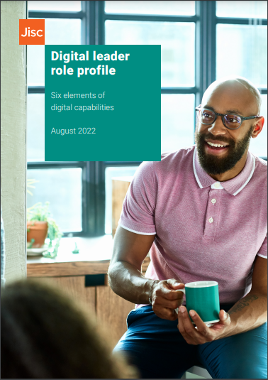
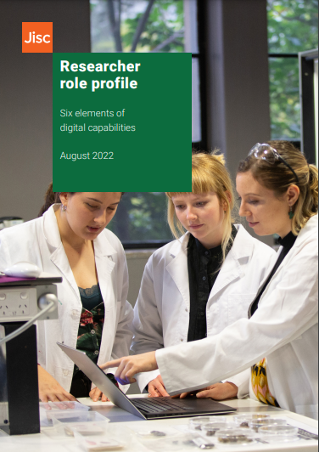
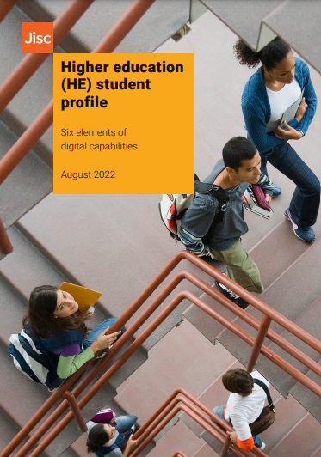
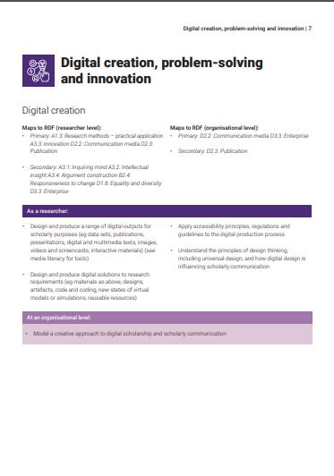
Putting the framework into context
Adapting the framework to your setting
Nine role profiles
HE teacher
FE teacher
Digital leader
Library information professional
Researcher
Learning technologist
Learner
Professional services staff
Researcher manager/professional

Slide 9
The discovery tool

Slide 10
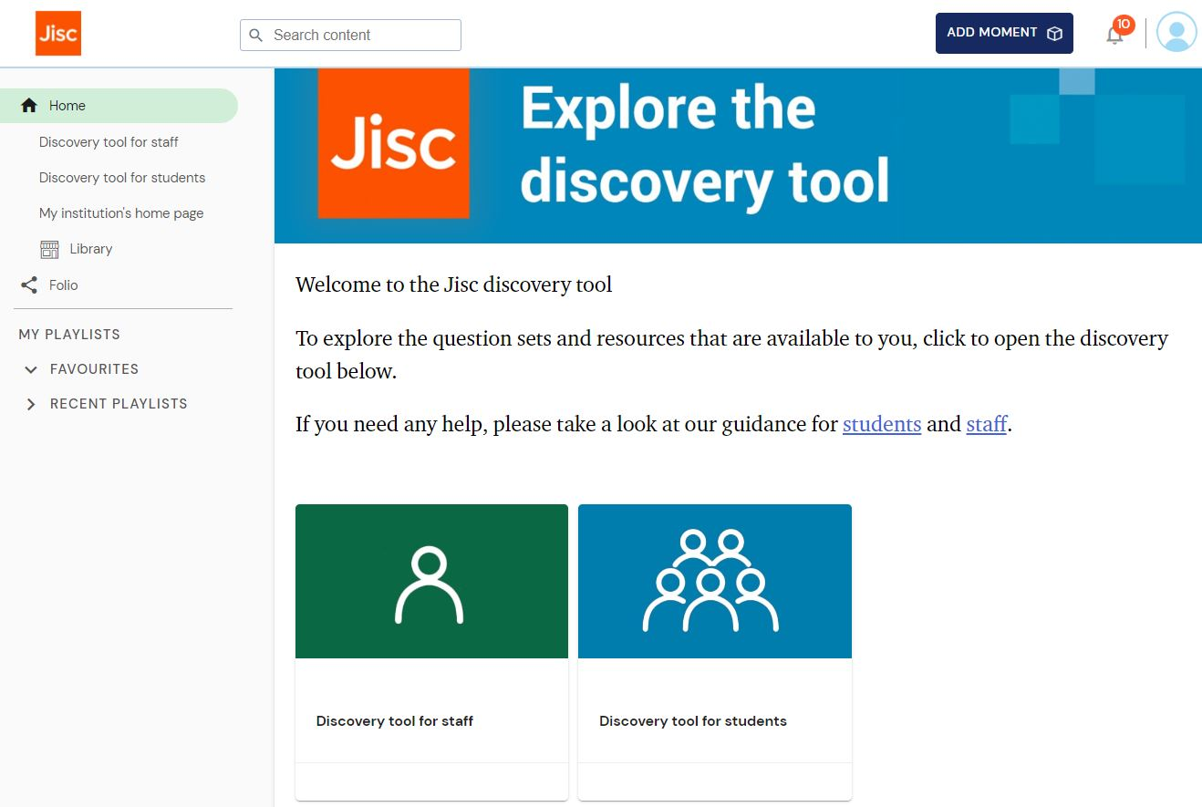
Starting a journey
Self-administered quiz
Initial concept developed and co-designed with sector bodies
Reflection not assessment
Notes:
Emerged from sector body initiated project

Slide 11
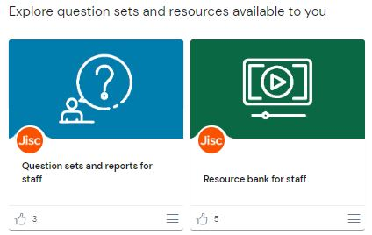
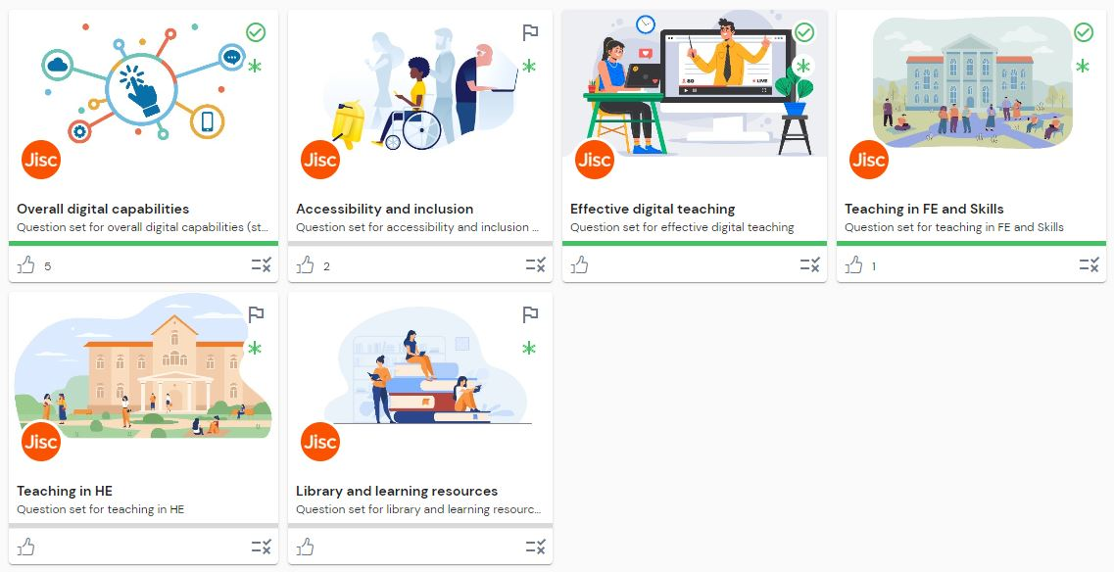
Navigating the journey

Slide 12
Tailored dashboards
Student
Staff

Slide 13
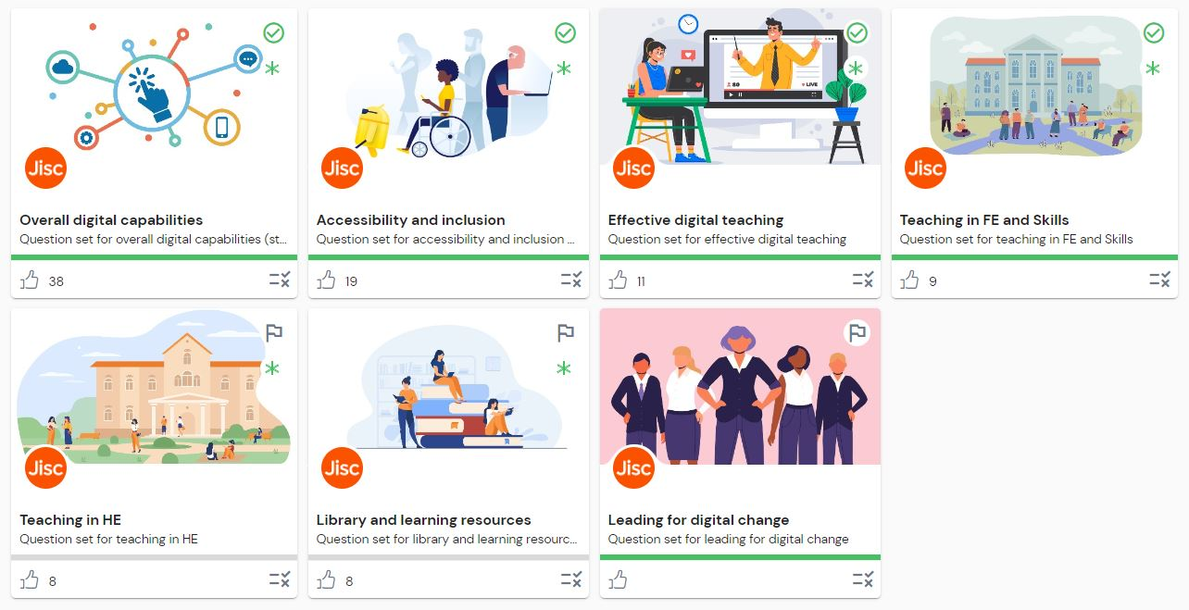
Staff
One size doesn’t fit all…
Question sets designed to suit your staff
Specific question set for online teaching
Accessibility and inclusion is essential
Leading for digital change to support organisational digital transformation

Slide 14
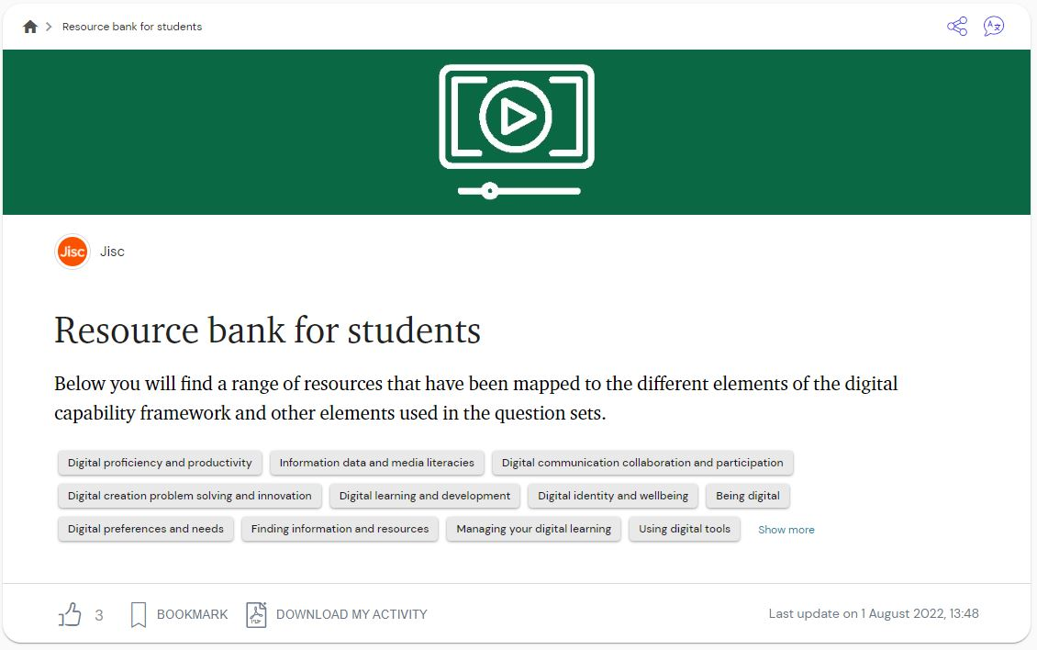
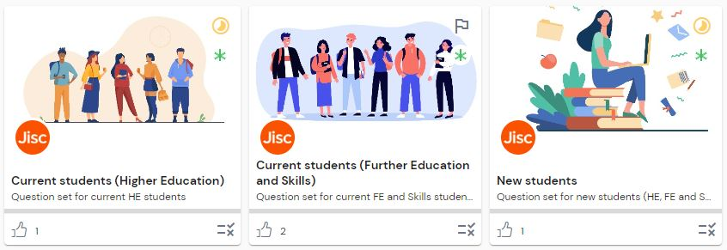
Students
Help them grow…
Launch digital capabilities on induction
Encourage reflection
Watch them develop
Create a student journey from induction to lifelong learning

Slide 15
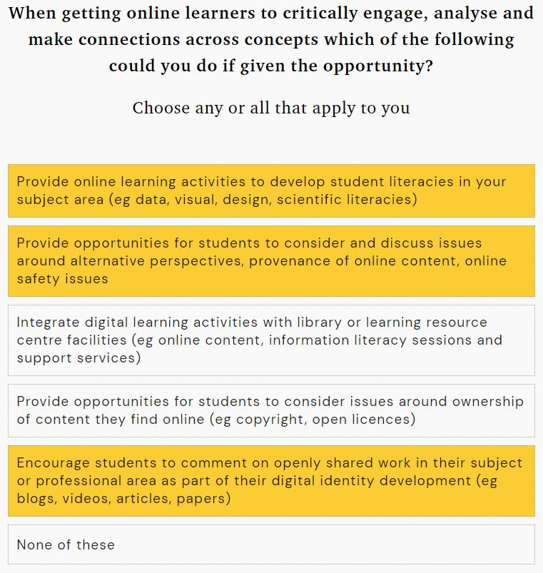
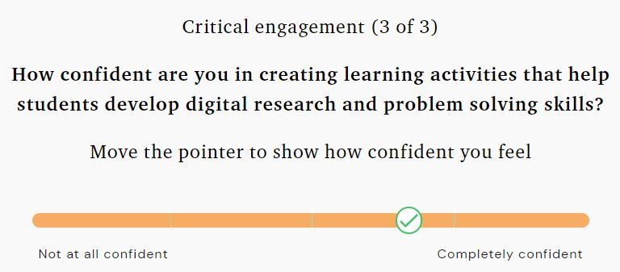
Reflective questioning
Confidence question
Activity ability (grid)

Slide 16
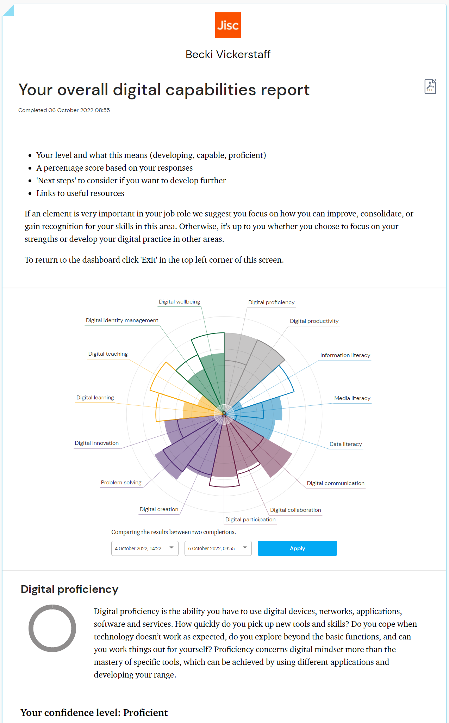
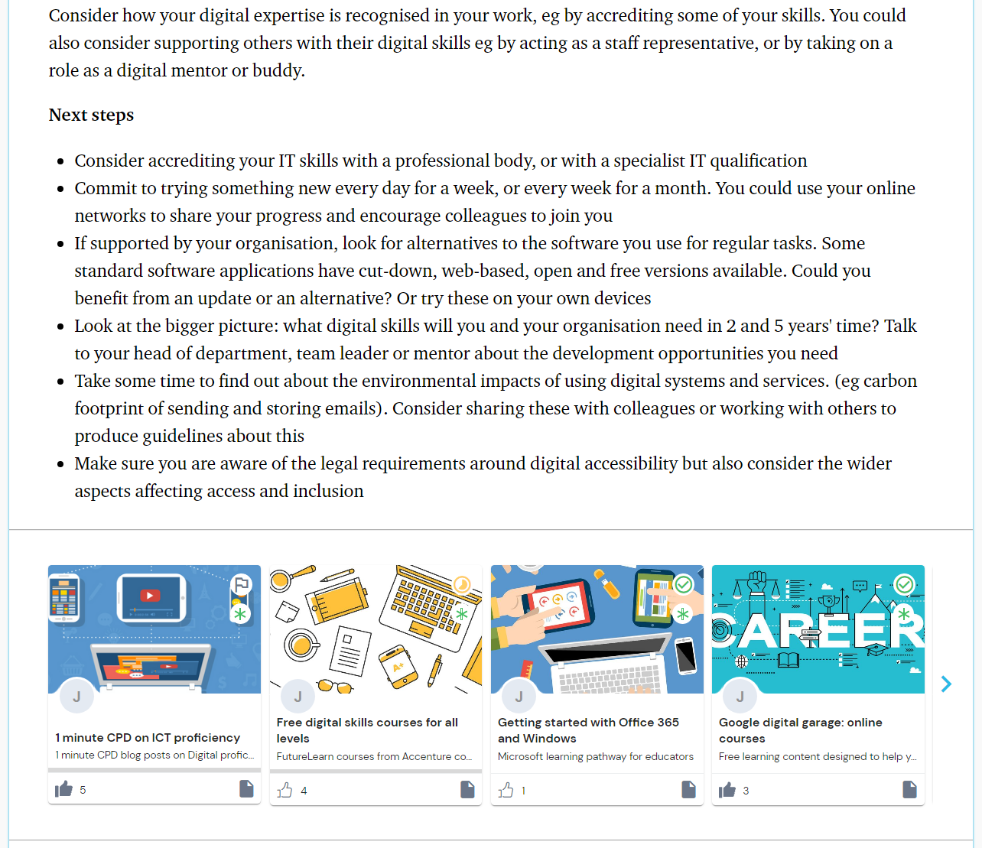
Personalised reports
Next steps
Overall digital capability radar
Links to resources
Report comparison overlay

Slide 17
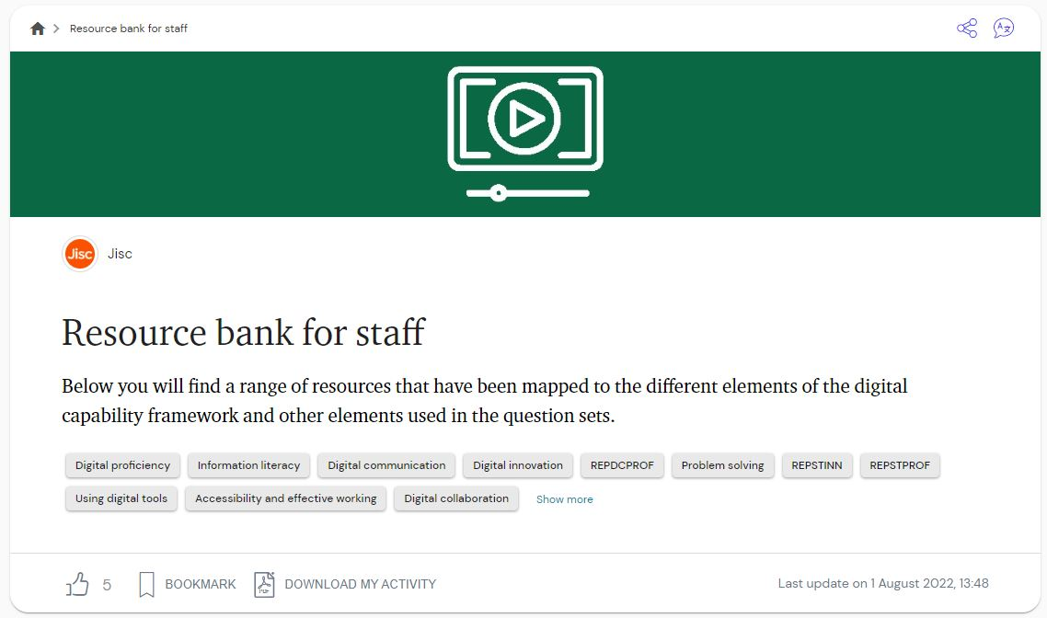
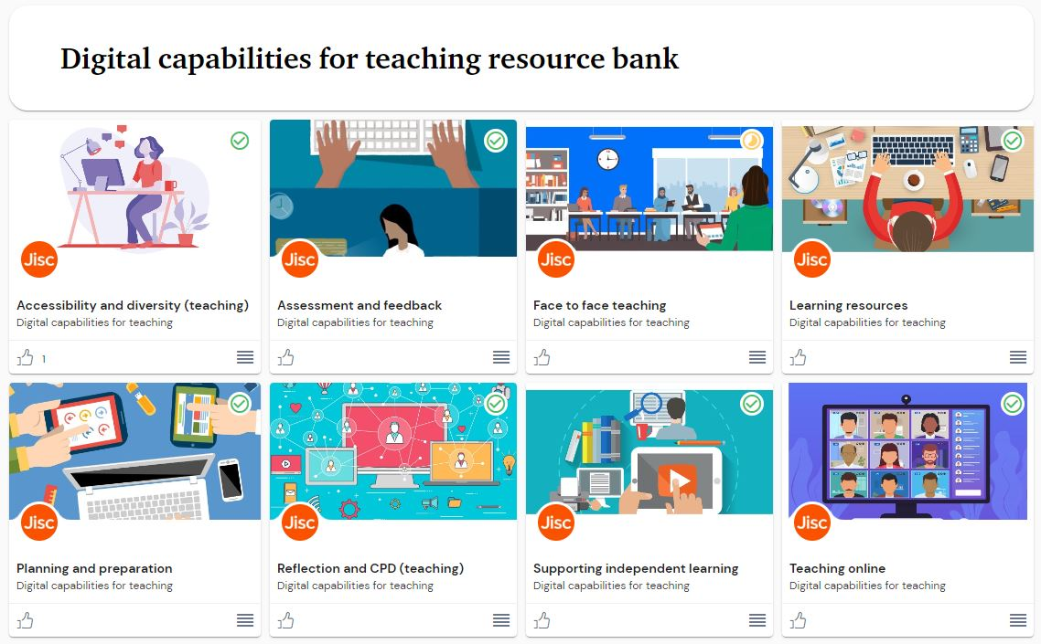
Resources
Over 800 resources available
Tailored to specific capabilities
Curated by sector professionals
Includes resources from leading organisations
Add links to your own resources
Bespoke for your own community
Closer aligned to organisational strategy

Slide 18
Implementing the discovery tool
Decide what will work in your setting
Plan, prepare, engage, communicate
Consider:
How could you use the tool?
What support needs to be in place?
How will you review, reflect and adapt?
How will you communicate?
How will you use data returns?
How will you evaluate

Slide 19
The data

Slide 20
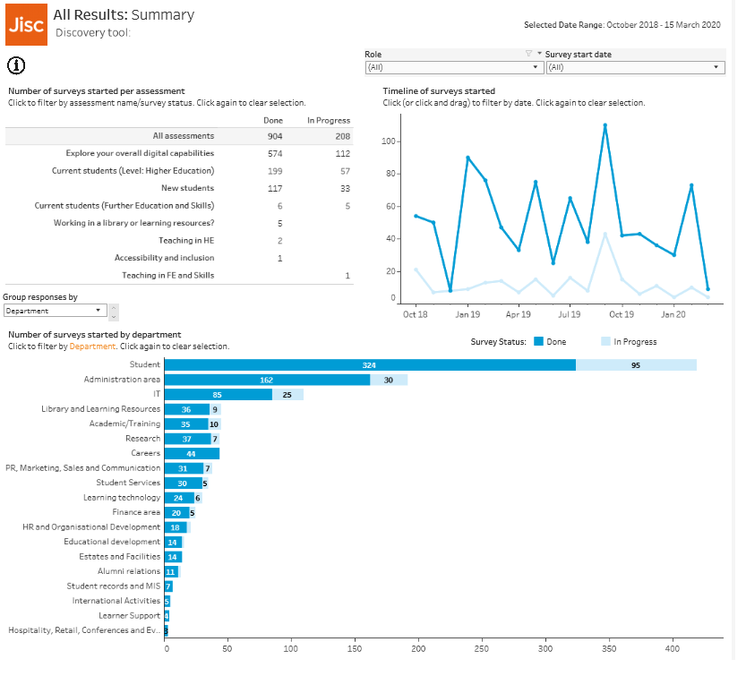
Monitor engagement and progress
Anonymised aggregated data
Department/subject reporting*
Monitor engagement over time
Identify trends
Develop campaigns
* department/subjects can be amended at organisational level

Slide 21
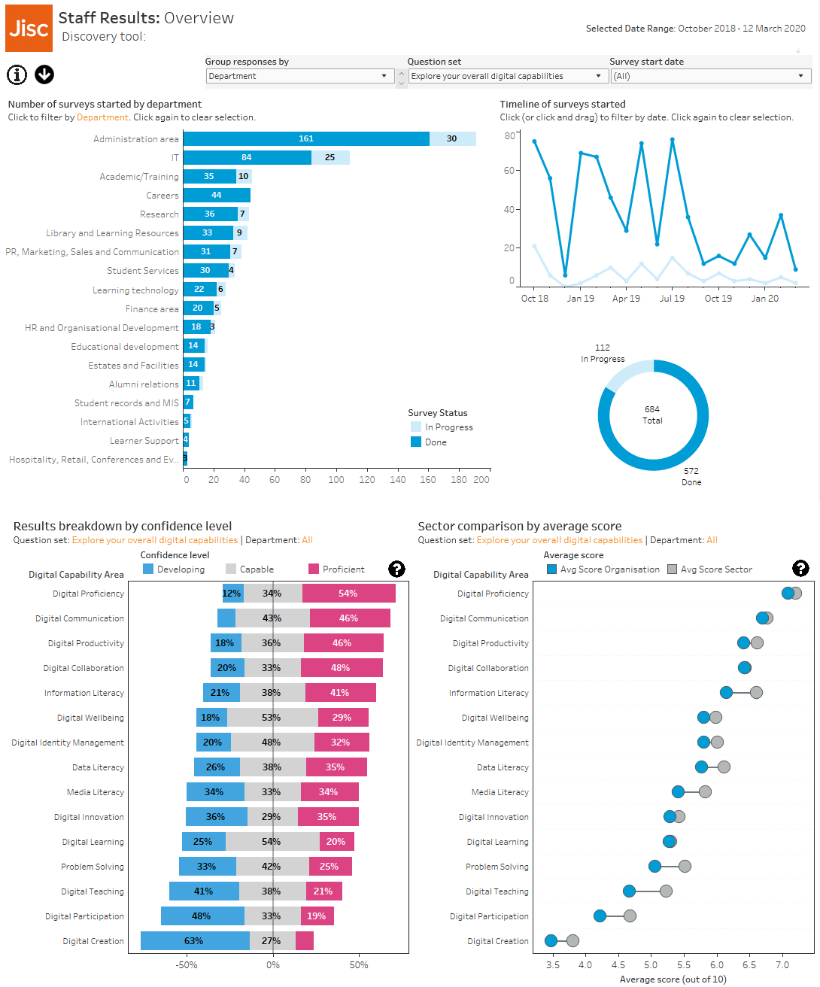
Assess overall capabilities and comparisons
Sector comparisons
Visual guides to department proficiencies (including tailored datasets)
Updated daily Monday - Friday

Slide 22
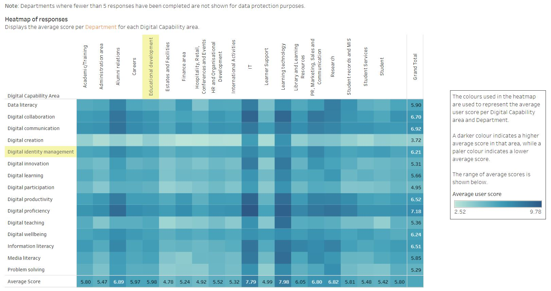
Easy visual summaries

Slide 23
Supporting you

Slide 24
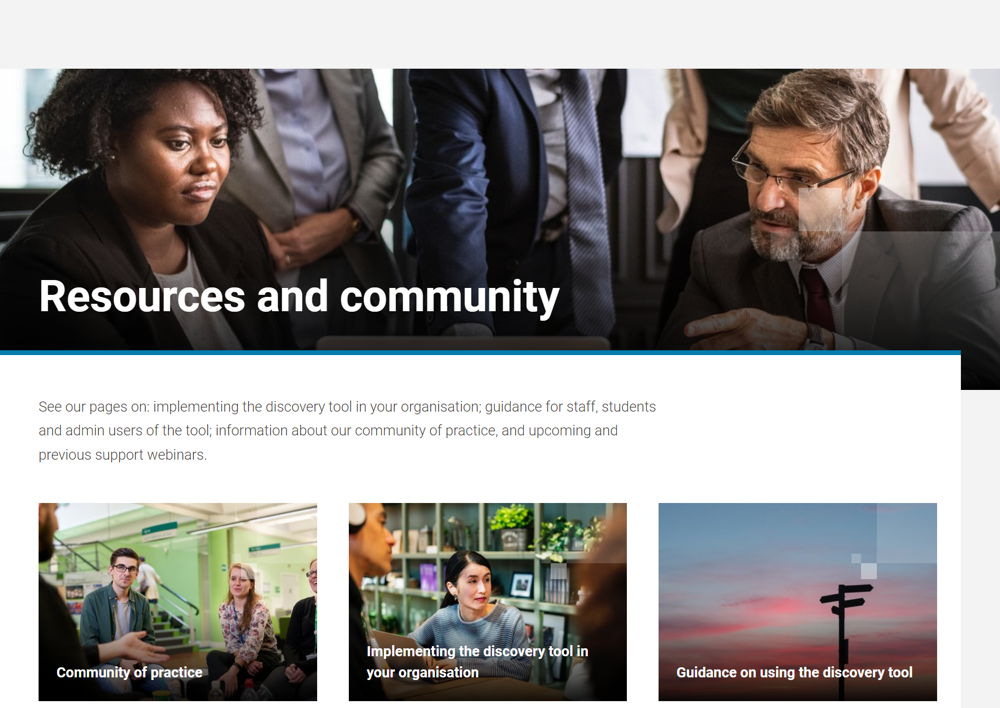
Exclusive access
Wealth of resources
Identifying a baseline
Getting started
Engaging users
Campaign materials
User guides

Slide 25
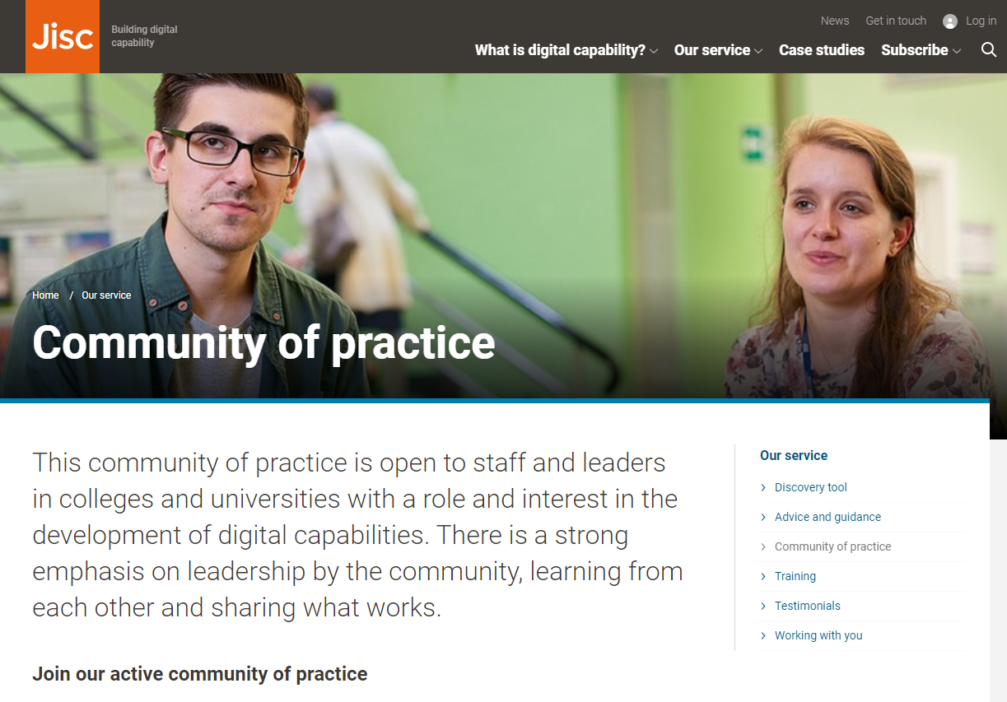
Welcome to the community
Twice-yearly community of practice events
Delivered by the community for the community
Opportunity to share best practice
Network with over 100 other professionals
Quarterly support webinars
Community MS Teams channel

Slide 26
The feedback

Slide 27
A growing community
Over 210 subscribers
Higher education
Further education
Skills development
International education
Over 30,000 individual users
Highly useful as a self-assessment tool, I will use the findings because particular actions are pinpointed
It has helped me focus and look to develop both my current skills and those areas of ignorance and the unknown
The final report is a great tool to break down the areas for improvement and also areas of confidence
Notes:
Need to update some quotes from customer feedback dec 2022

Slide 28
Thank you – we hope you join our community

Slide 29
Contact us
help@jisc.ac.uk

